Slide 1
BuzzCopper
Jonathan Semple
January 2026
https://buzzcopper.org

Slide 2
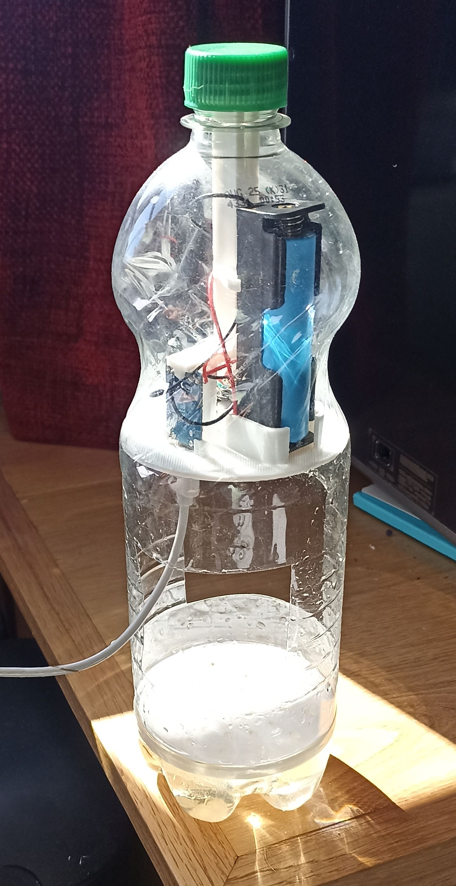
BuzzCopper
AI powered Asian Hornet detector
Very cheap (around £25 cost of parts)
Can be powered from a small solar panel
Zero by-catch
Sends alerts by email over WiFi
Open source software

Slide 3
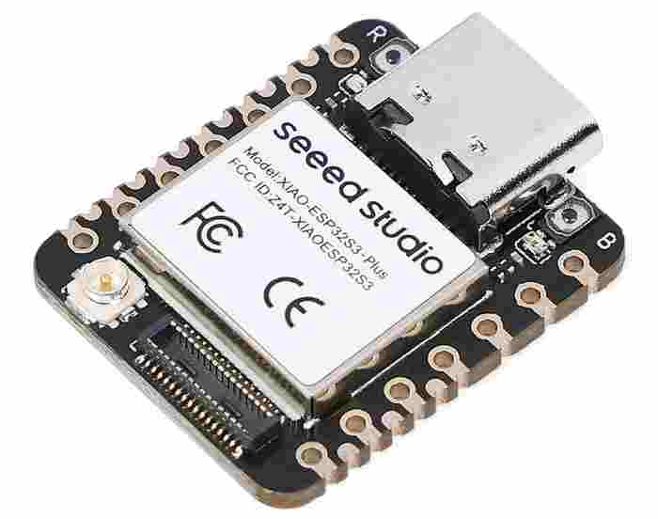
BuzzCopper ingredients
Microcontroller (ESP32S3)

Slide 4
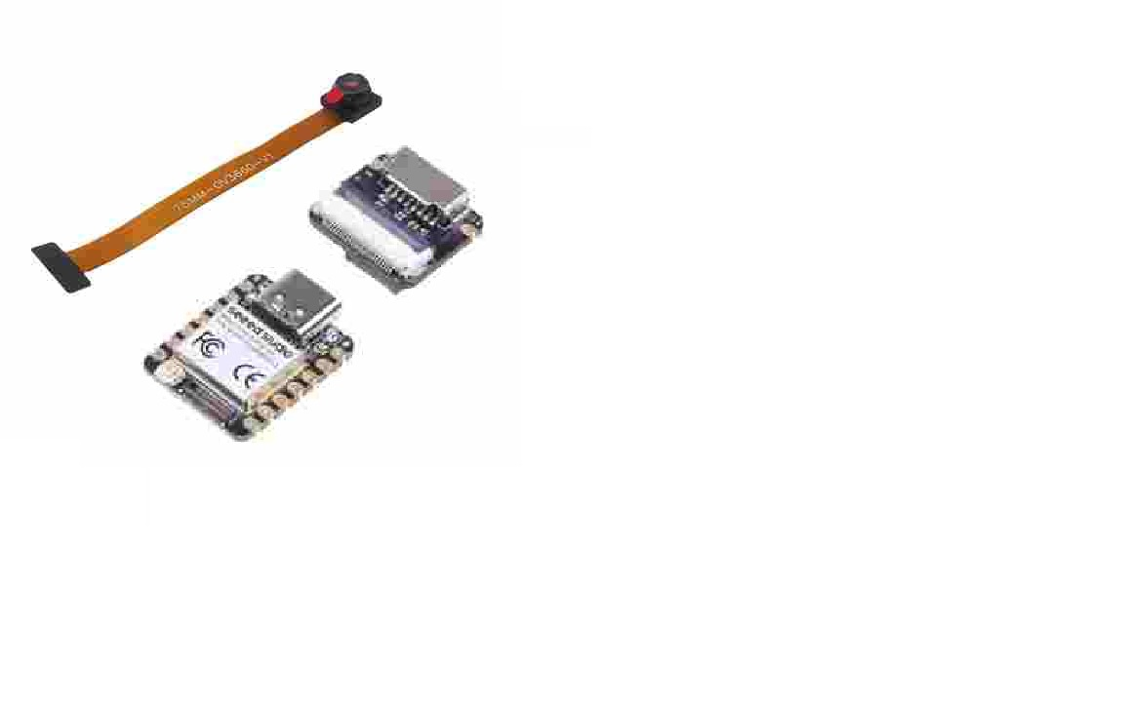
BuzzCopper ingredients
Microcontroller (ESP32S3)
Camera

Slide 5
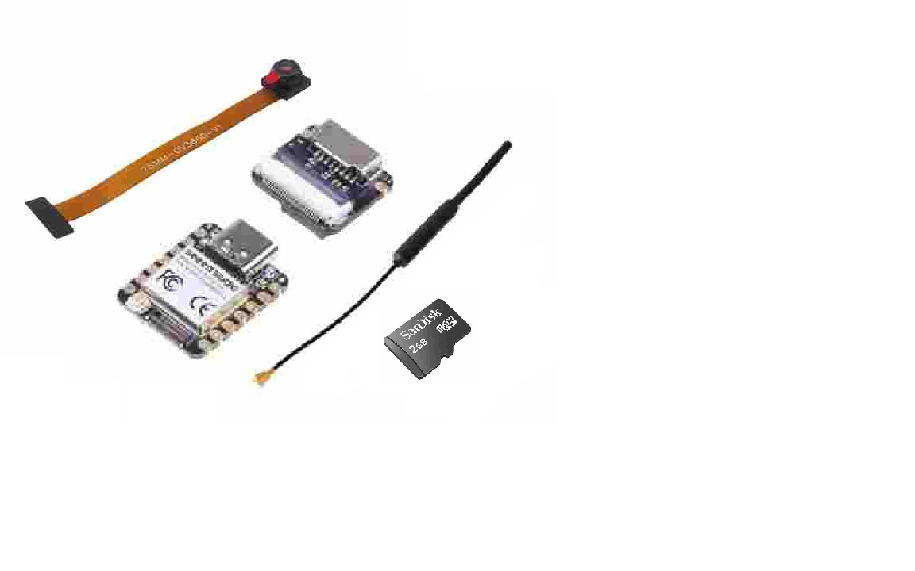
BuzzCopper ingredients
Microcontroller (ESP32S3)
Camera
WiFi aerial
SD card

Slide 6
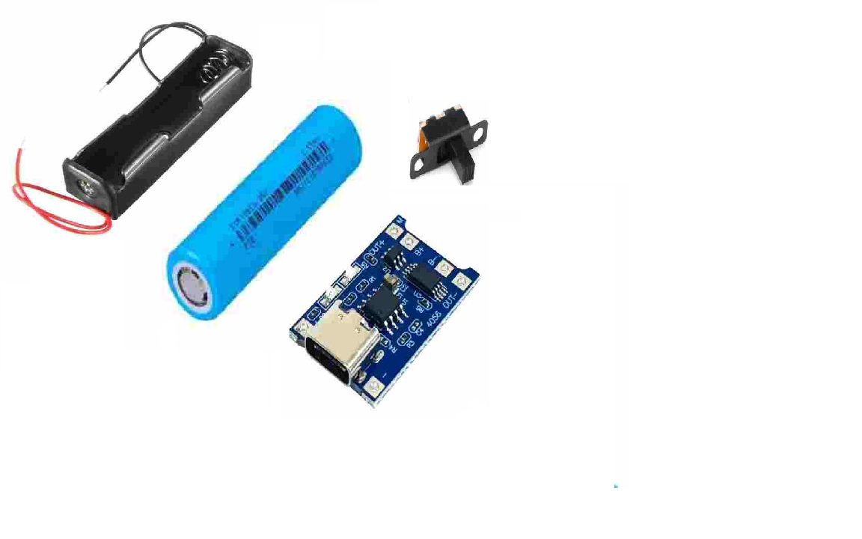
BuzzCopper ingredients
Microcontroller (ESP32S3)
Camera
WiFi aerial
SD card
Battery, charger module and switch

Slide 7
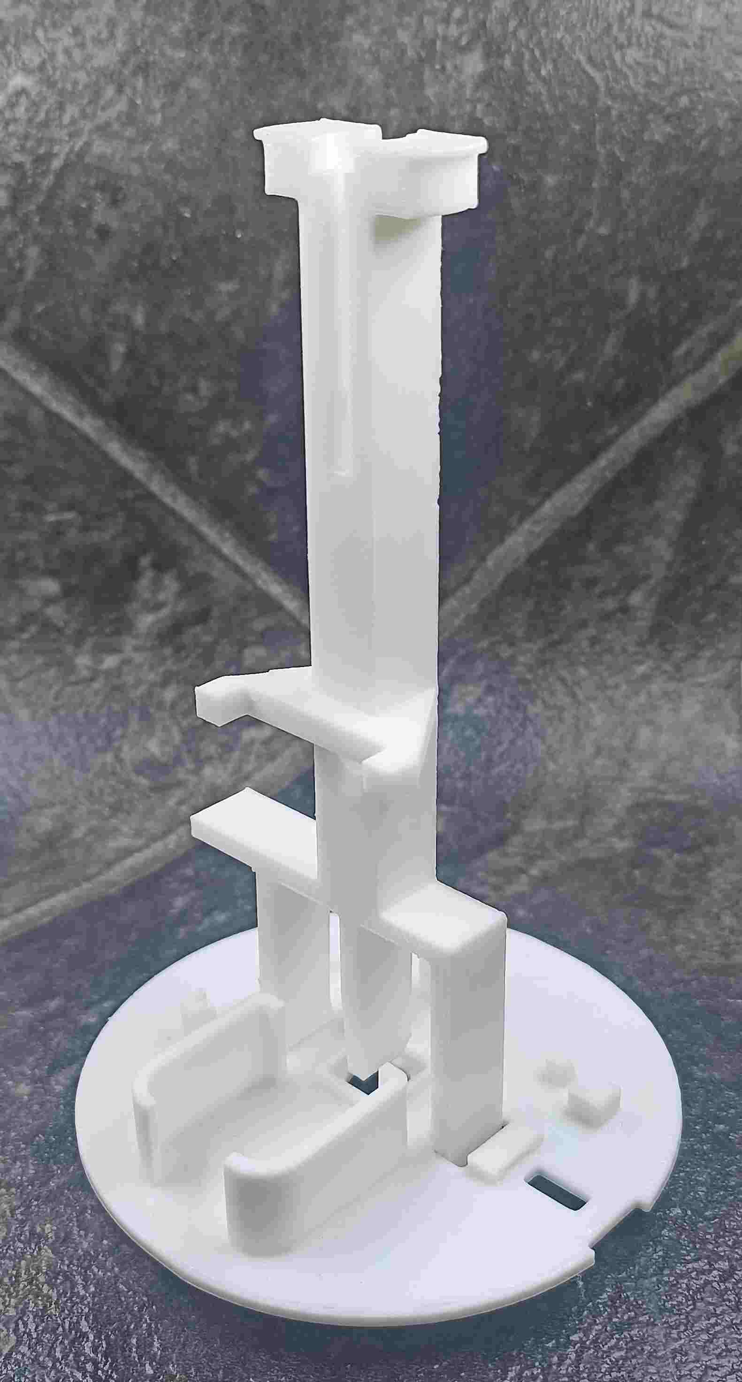
BuzzCopper ingredients
Microcontroller (ESP32S3)
Camera
WiFi aerial
SD card
Battery, charger module and switch
3D printed scaffolding

Slide 8
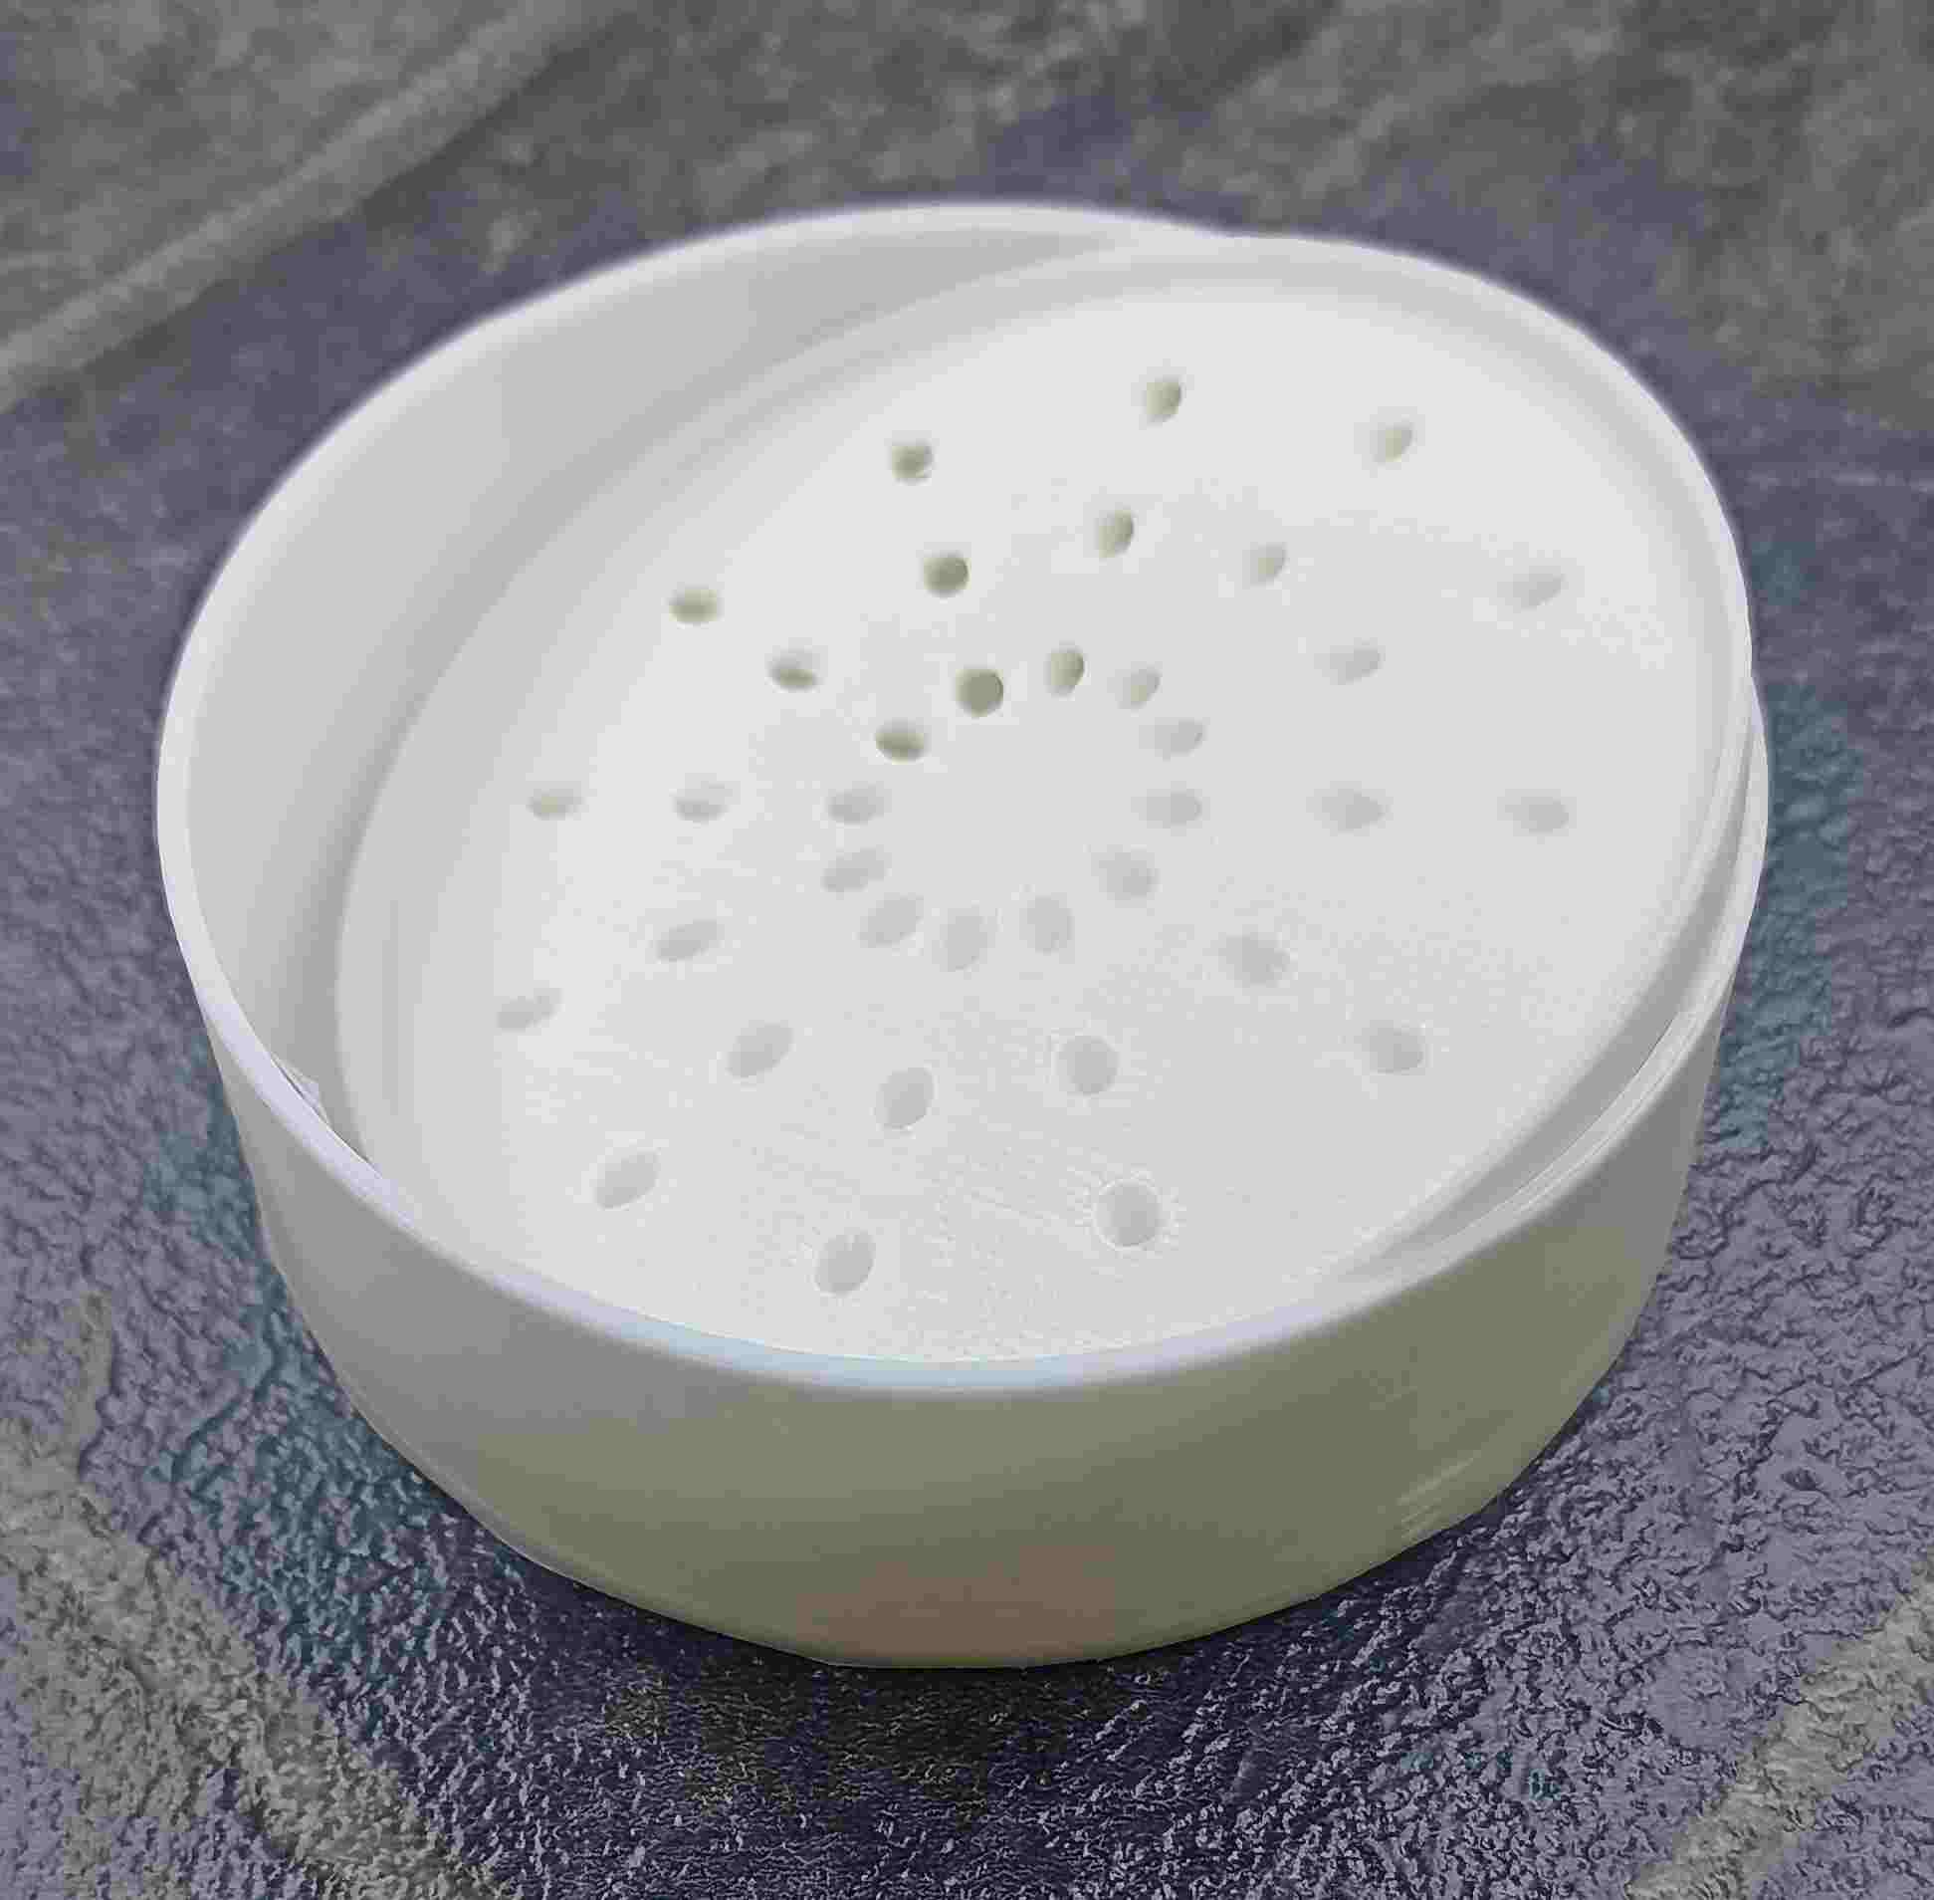
BuzzCopper ingredients
Microcontroller (ESP32S3)
Camera
WiFi aerial
SD card
Battery, charger module and switch
3D printed scaffolding
Bait station

Slide 9

BuzzCopper ingredients
Microcontroller (ESP32S3)
Camera
WiFi aerial
SD card
Battery, charger module and switch
3D printed scaffolding
Bait station
Enclosure

Slide 10
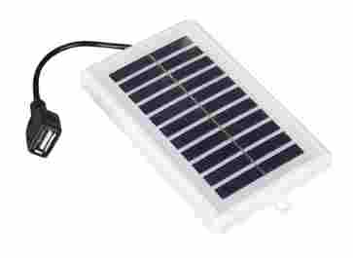
BuzzCopper ingredients
Microcontroller (ESP32S3)
Camera
WiFi aerial
SD card
Battery, charger module and switch
3D printed scaffolding
Bait station
Enclosure
Small solar panel

Slide 11

BuzzCopper ingredients
Microcontroller (ESP32S3)
Camera
WiFi aerial
SD card
Battery, charger module and switch
3D printed scaffolding
Bait station
Enclosure
Small solar panel
2 man-years of software

Slide 12
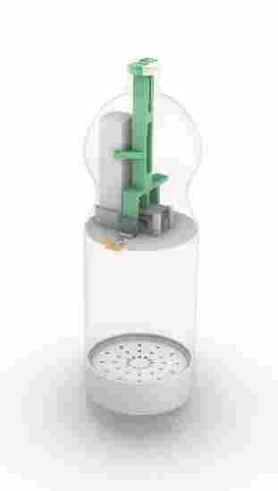
How it works

Slide 13
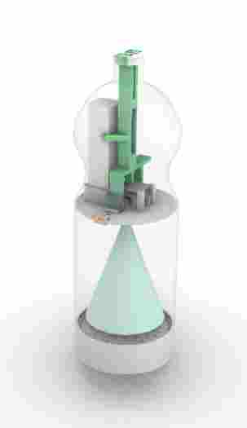
How it works
Take a photo of the bait station

Slide 14
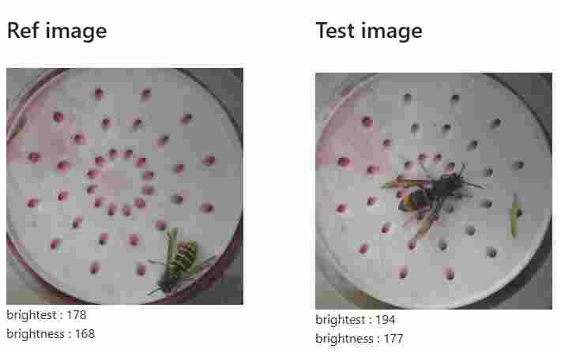
How it works
Take a photo of the bait station
Compare the previous and latest photos

Slide 15
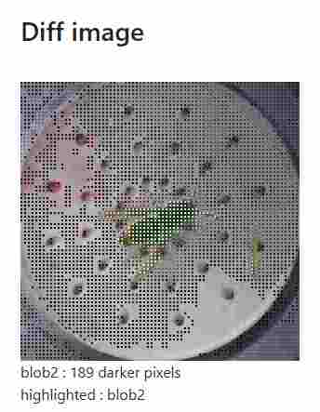
How it works
Take a photo of the bait station
Compare the previous and latest photos
Find new potential insect shapes

Slide 16
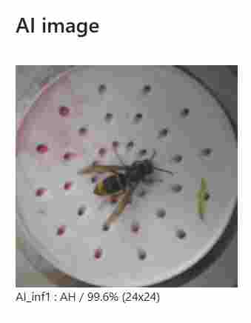
How it works
Take a photo of the bait station
Compare the previous and latest photos
Find new potential insect shapes
Run AI on the photo

Slide 17
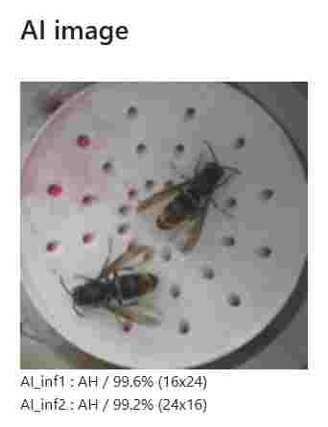
How it works
Take a photo of the bait station
Compare the previous and latest photos
Find new potential insect shapes
Run AI on the photo

Slide 18
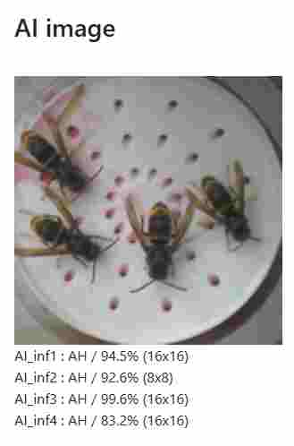
How it works
Take a photo of the bait station
Compare the previous and latest photos
Find new potential insect shapes
Run AI on the photo

Slide 19
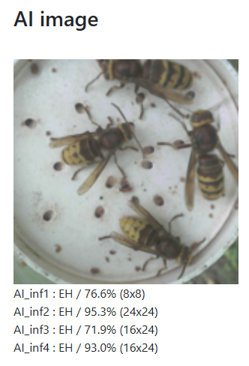
How it works
Take a photo of the bait station
Compare the previous and latest photos
Find new potential insect shapes
Run AI on the photo

Slide 20
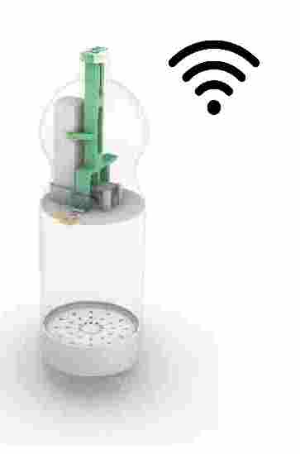
How it works
Take a photo of the bait station
Compare the previous and latest photos
Find new potential insect shapes
Run AI on the photo
Connect to WiFi

Slide 21
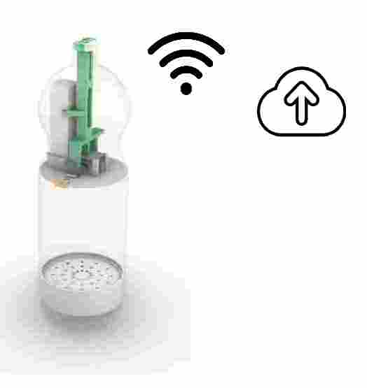
How it works
Take a photo of the bait station
Compare the previous and latest photos
Find new potential insect shapes
Run AI on the photo
Connect to WiFi
Upload photos

Slide 22
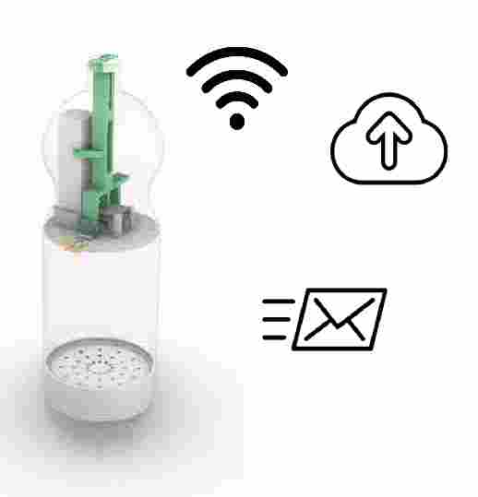
How it works
Take a photo of the bait station
Compare the previous and latest photos
Find new potential insect shapes
Run AI on the photo
Connect to WiFi
Upload photos
Send an email alert

Slide 23
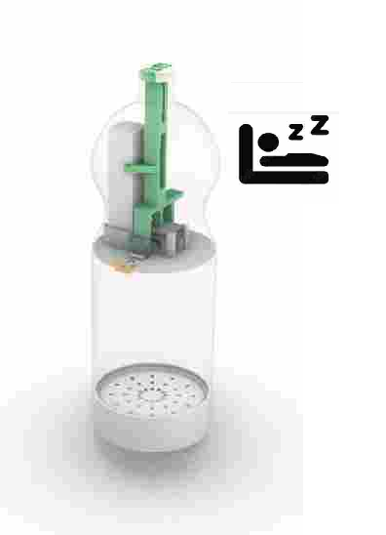
How it works
Take a photo of the bait station
Compare the previous and latest photos
Find new potential insect shapes
Run AI on the photo
Connect to WiFi
Upload photos
Send an email alert
Go to sleep

Slide 24
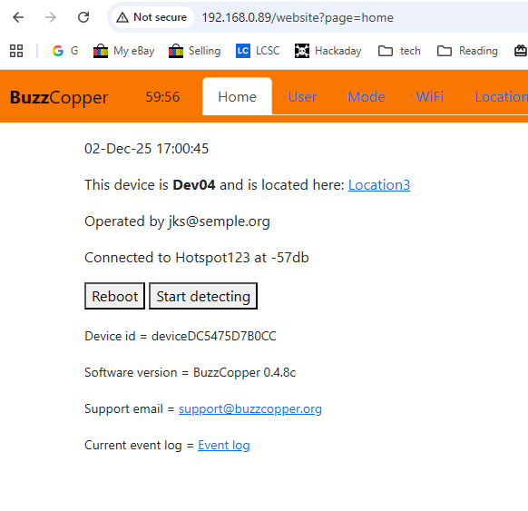
Control panel
Wifi credentials
Email address(es)
Current location
Dawn and dusk
Detection parameters
Error messages

Slide 25
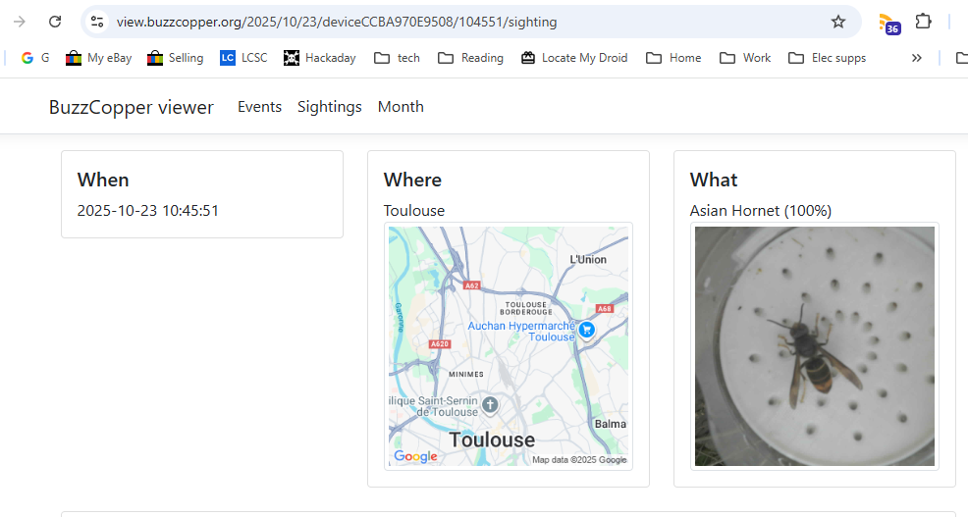
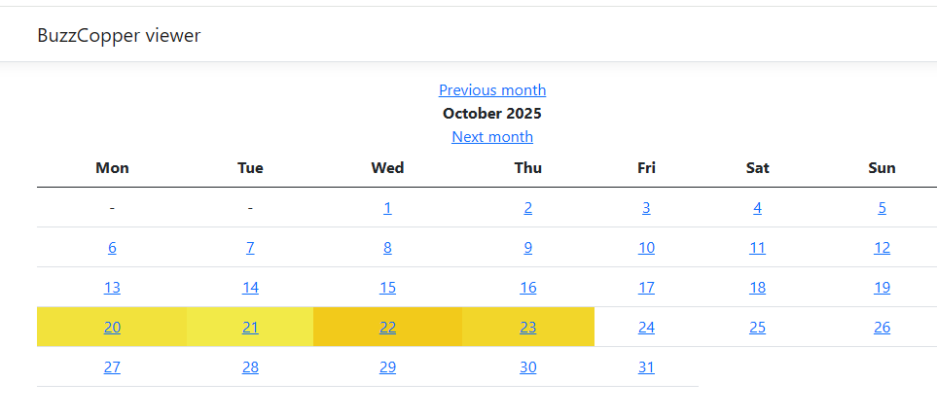
Cloud image store
All images from all devices
..with metadata
Browse around

Slide 26
Other features
Over-the-Air firmware updates
Retest old images
Store and forward if WiFi not available
QR code reader for WiFi credentials
Upload core dumps to the Cloud

Slide 27
Highlights of the year
First device deployed on 8 June
First batch of devices ready end of June
First Asian Hornet sighting 13 July
100s of AH pics by mid August
First AI model deployed 8 Sep
Trademark granted 21 Nov
~70 devices built by end of season
Custom PCB designed Dec 31

Slide 28
Plan for 2026
Bug fixing
Better AI
BuzzCopper2
Production for June 2026
Promotion

Slide 29
Improving the AI
V1 – Google Vision
V2 – EdgeImpulse FOMO 150x150
V3 – EdgeImpulse 150x150 with tweaks
V4 – EdgeImpulse 160x160
V5 – EdgeImpulse 80x80
V6 – EdgeImpulse YOLO ?

Slide 30
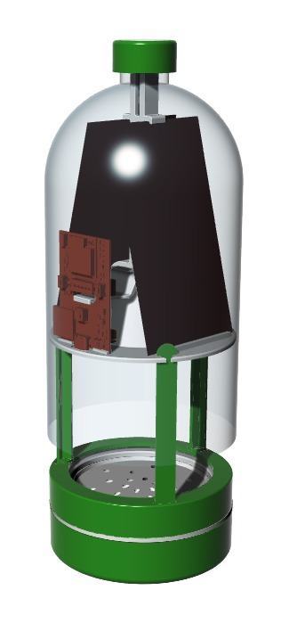
BuzzCopper2
Larger enclosure

Slide 31
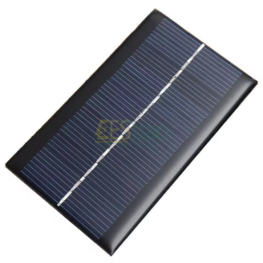
BuzzCopper2
Larger enclosure
Internal solar panels

Slide 32
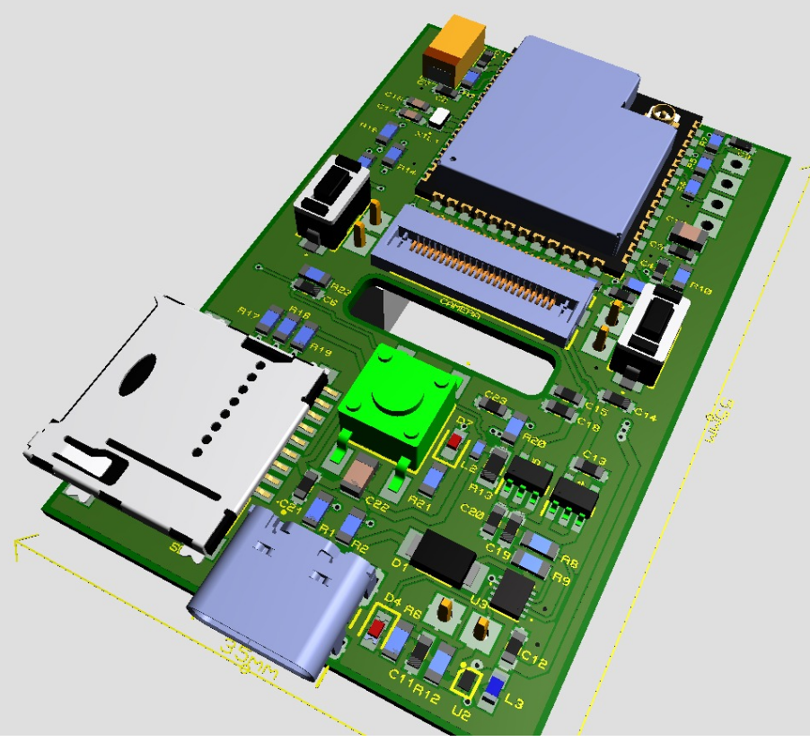
BuzzCopper2
Larger enclosure
Internal solar panels
Custom designed processor PCB

Slide 33
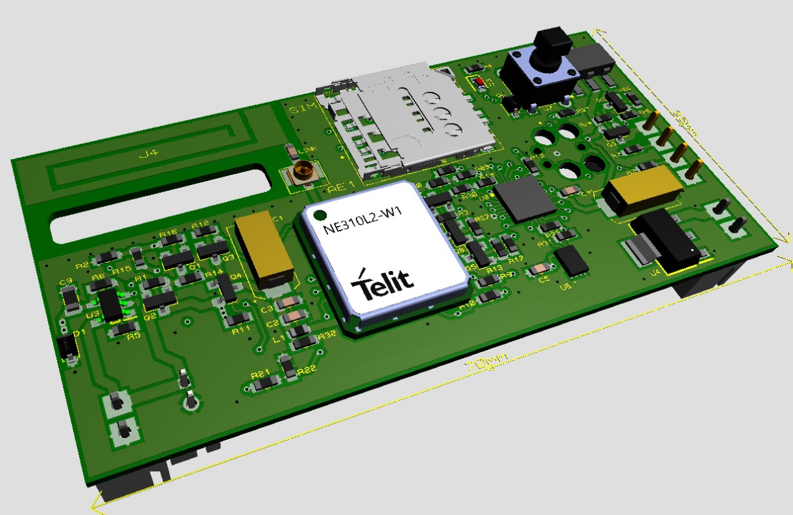
BuzzCopper2
Larger enclosure
Internal solar panels
Custom designed processor PCB
Cellular radio option

Slide 34
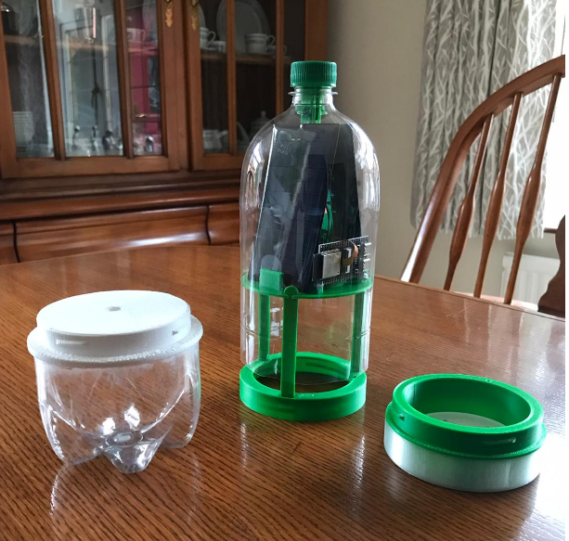
BuzzCopper2
Larger enclosure
Internal solar panels
Custom designed PCB
Cellular radio option
Larger bait pot
More insect access

Slide 35
Production
Volunteer network
Possible manufacturer licensing
How many?
Give us an idea at preorders@buzzcopper.org
Can anyone help?

Slide 36
Promotion
Talks
Fund-raising

Slide 37
Questions

