Slide 1

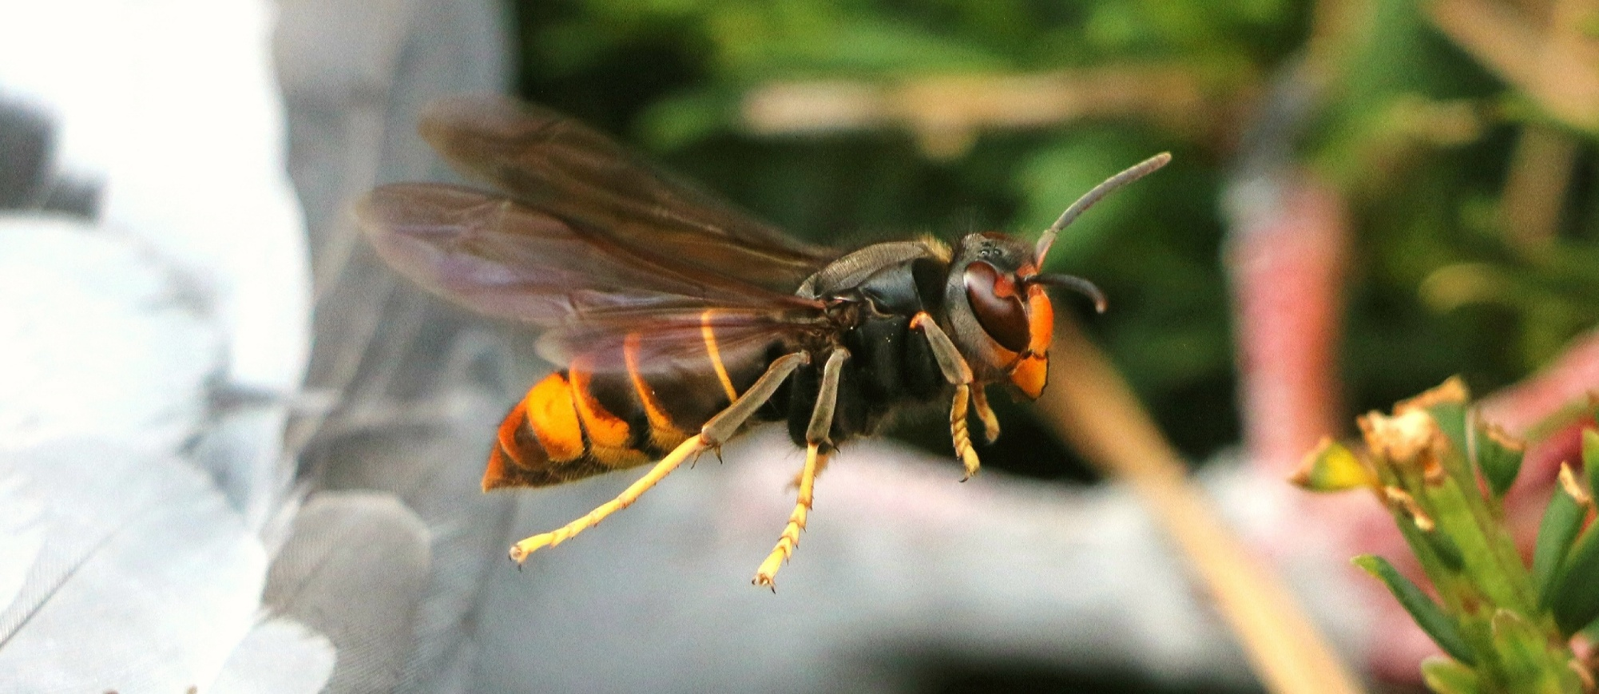
The Yellow-Legged
Asian Hornet
As modified and updated by Andrew Brown – Cumbria Asian Hornet Team Coordinator - 15th April 2026

Slide 2

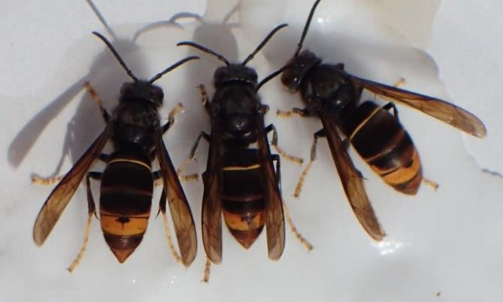
The Yellow-legged Asian Hornet is a non-native invasive species that preys on a wide range of pollinators including honey bees.
Image: Bob Hogge

Slide 3

  Native to Asia: South China, Myanma, Indonesia
  First seen in France in 2004 – thought to have arrived in a container of pottery from China
  Now present across most of Europe
  UK is facing an increasing threat from this invasive species
  Preys on a wide range of insects not just honey bees

Slide 4
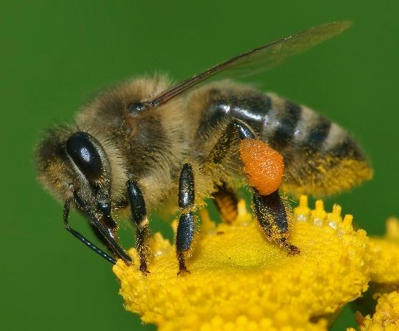
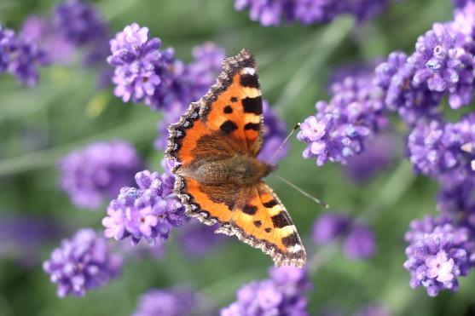
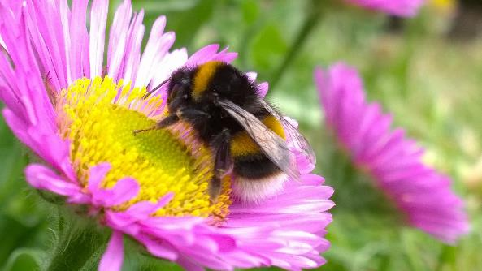
  One nest, of Yellow-legged Asian hornets, can eat 100,000 pollinators in one year
This Photo by Unknown Author is licensed under CC BY-SA

Slide 5
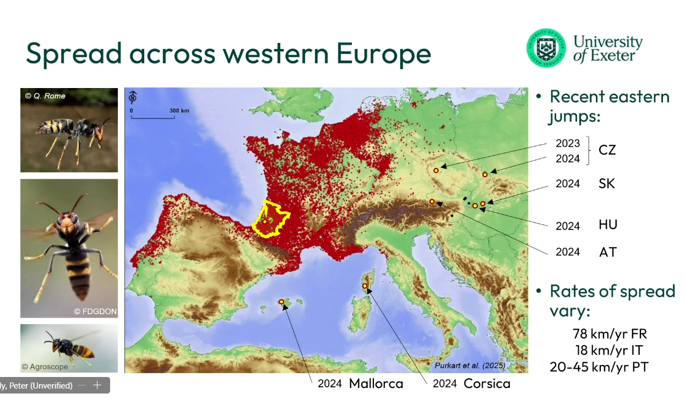
Notes:
https://frelonasiatique.mnhn.fr/ for up to date maps and dynamic versions

Slide 6
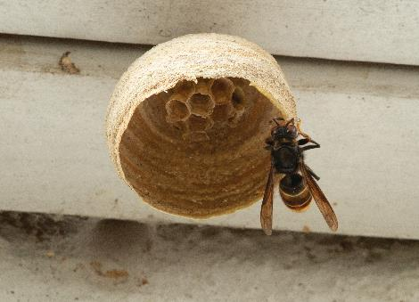
  Spring
  Over-wintered queens become active and start foraging
  Build a primary nest typically in a lowdown sheltered spot and begin the production of a new colony
  Nest is brown in colour, similar to a wasp nest
  Only fly during the day
Image: John De Carteret

Slide 7
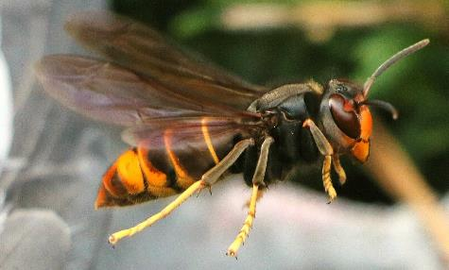
  Summer
Image: Pixabay
  The queens build a larger secondary nest which is typically in an elevated position
  A single colony can produce up to 6000 individuals in one season.
  Can be spotted ‘hawking’ honey bees outside their hive

Slide 8
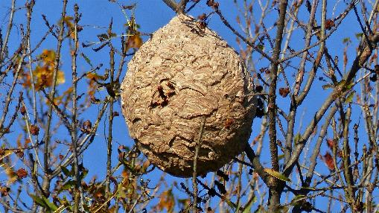
  Autumn
Image: Claude Alleva on Pixabay
  Nests high up in trees more likely to be seen when the leaves start to fall
  Can be seen foraging on flowering ivy and fallen fruit
  Mated queens leave the nest to find a suitable place to over-winter and leave the workers and males to die

Slide 9
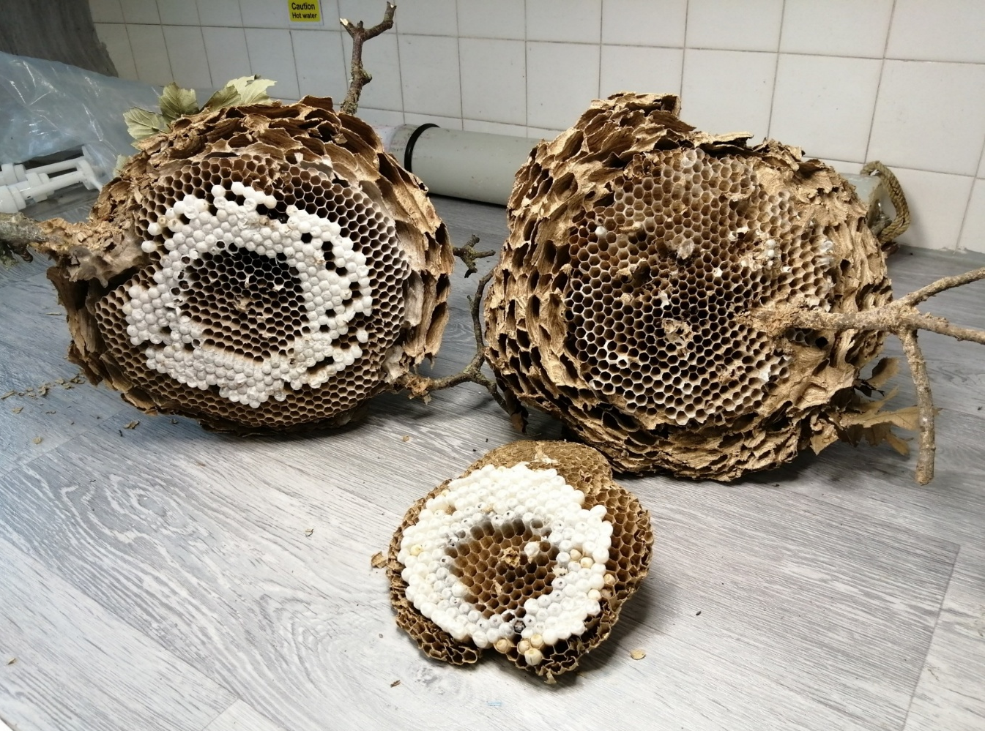
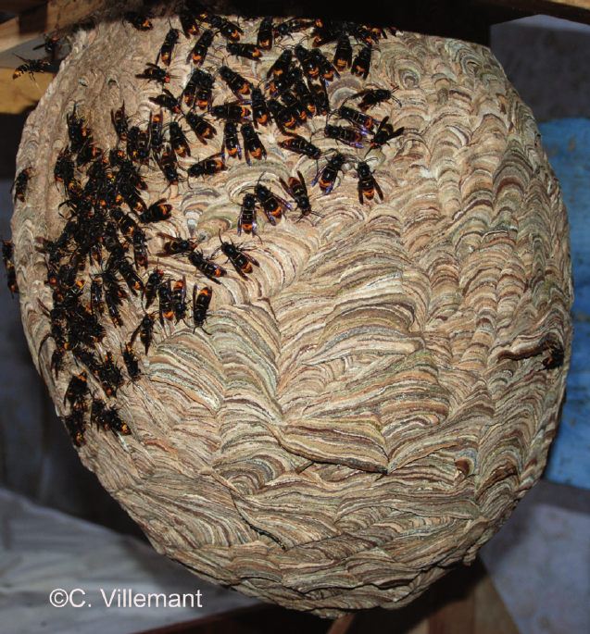
Secondary Nest – May/October
"Courtesy The Animal and Plant Health Agency - Julia Hoggard (APHA), Crown Copyright"
Notes:
Asian hornet nest dissected, white parts are cocoons

Slide 10
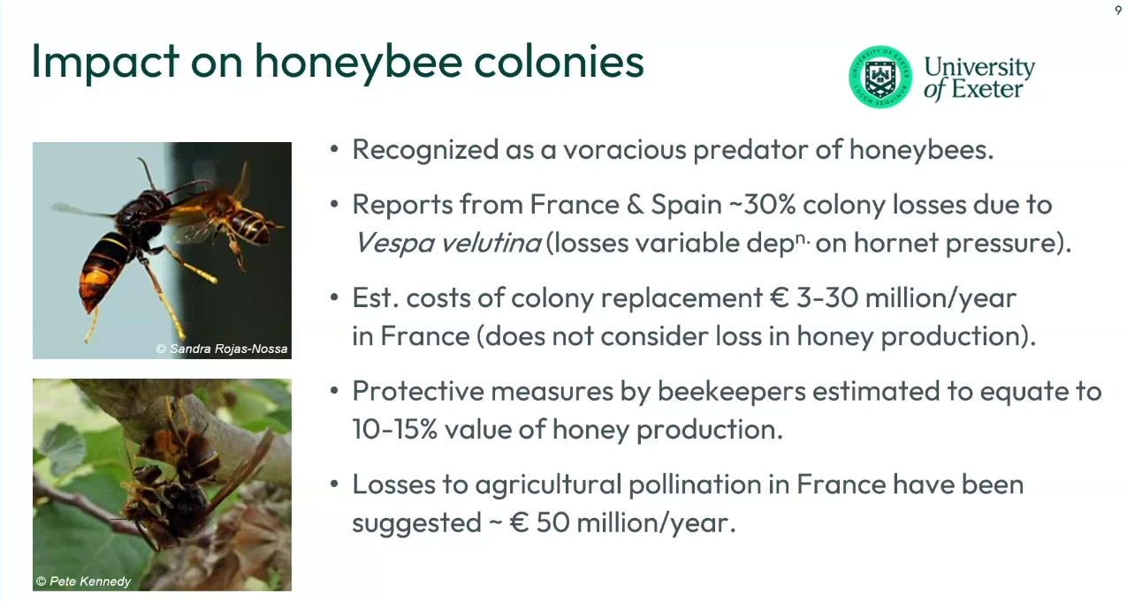

Slide 11
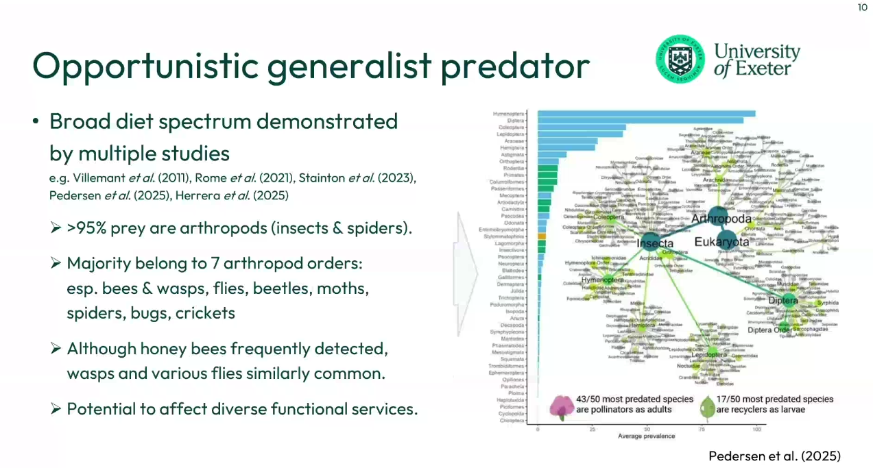

Slide 12
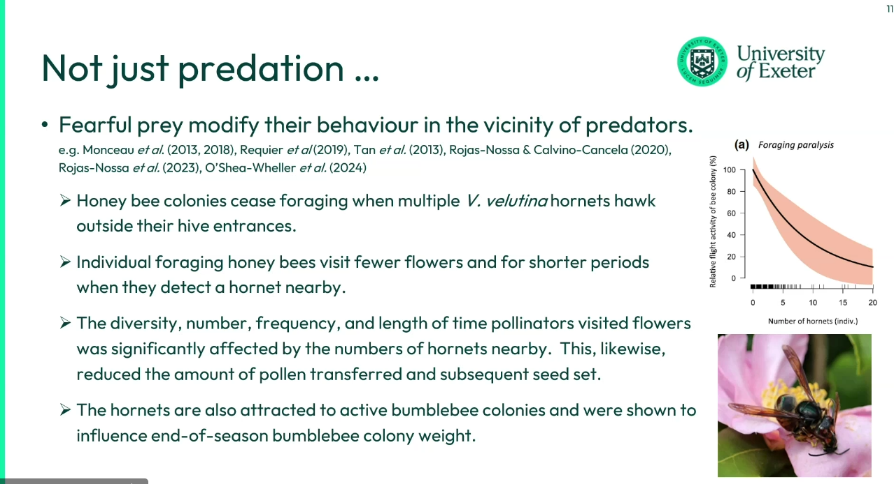

Slide 13
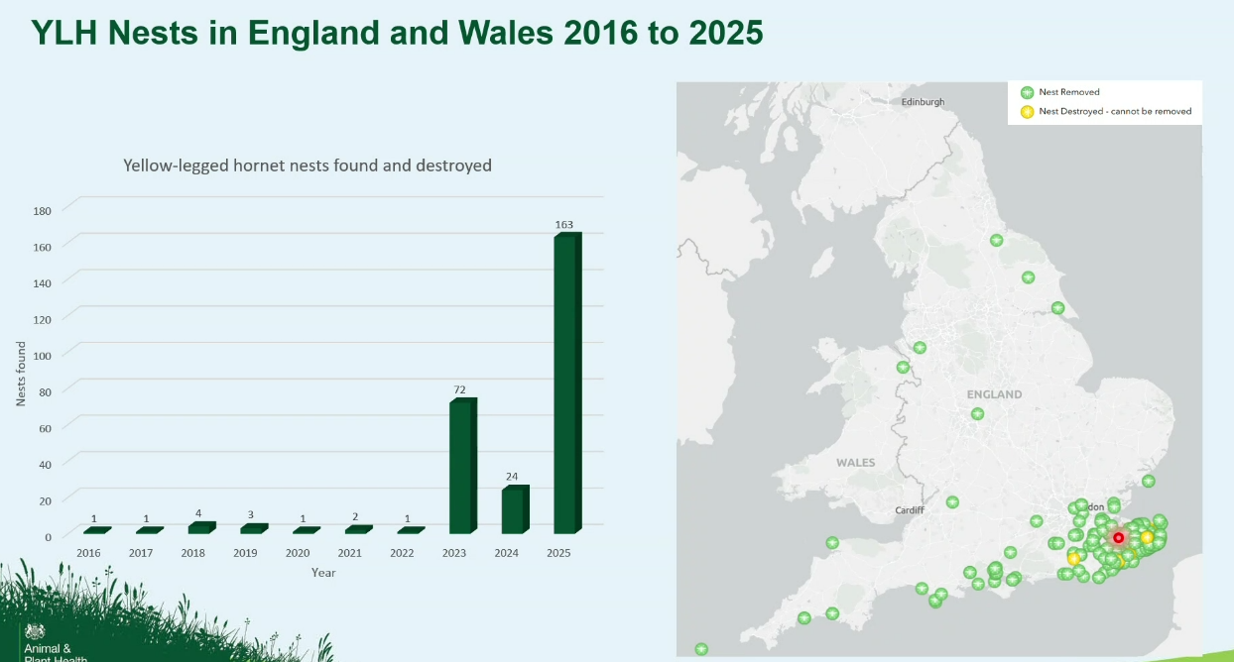
As of December 2025, 544 credible Yellow-legged Asian Hornet sightings have been reported in the UK and 163 nests have been found.

Slide 14
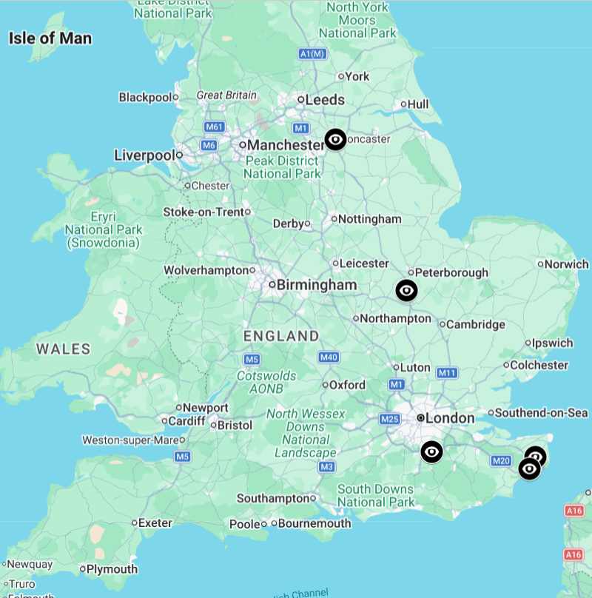
2026 Sightings, so far
As of April 2026, 2 credible Yellow-legged Asian Hornet sightings near Doncaster and in Sawey, near Cambridge.
This month, 3 early queen captures, in Surrey and Kent
Also, a January discovery of an abandoned secondary nest near Wrexham

Slide 15
We need everyone’s help!
  Learn how to identify Yellow-legged Asian Hornets
  Know how to report any sightings
  Be vigilant
  Spread the word

Slide 16

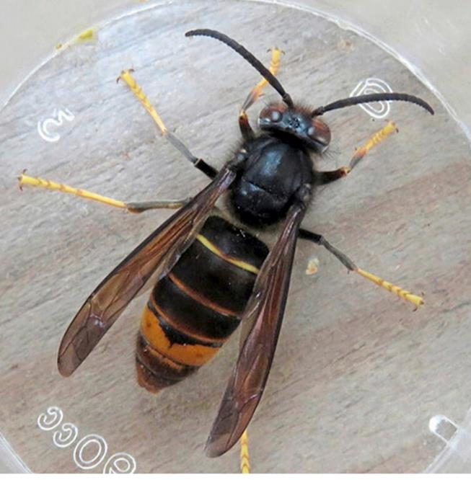
Identification
  Dark abdomen with wide orange stripe on 4th segment
  Yellow tips to legs
  Head black with orange face
  Thorax black & velvety
Image: David Walker

Slide 17
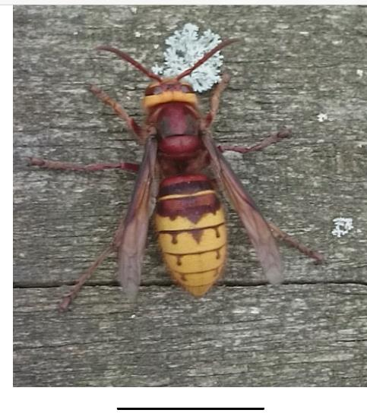
Similar Insects
  Native European Hornet
  Larger in size
  Yellow & brown
  Brown legs
  Yellow headband

Slide 18
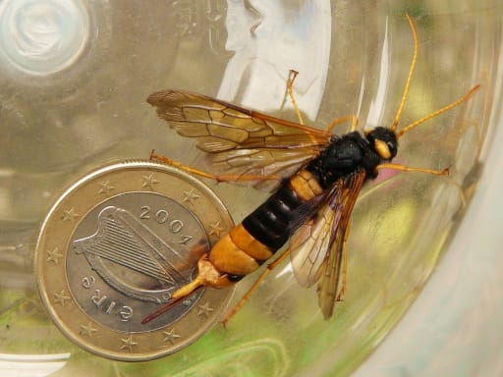
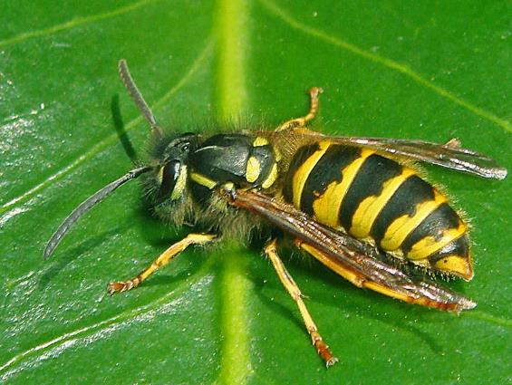
Similar Insects
  Giant Wood Wasp
  Wasp

Slide 19
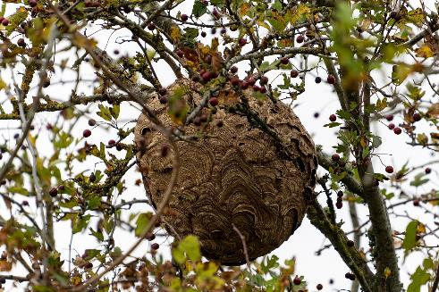

Image: Didier Aires on Pixabay
  Yellow-legged Asian hornets can be extremely aggressive if they feel they are being threatened. Stings are painful and can cause an allergic reaction in some people.
  Do not approach or disturb a nest.

Slide 20
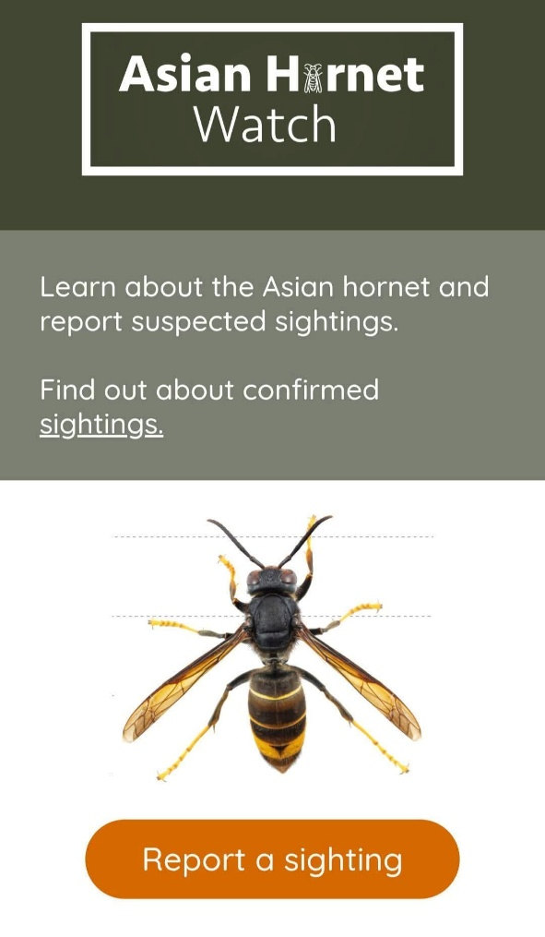
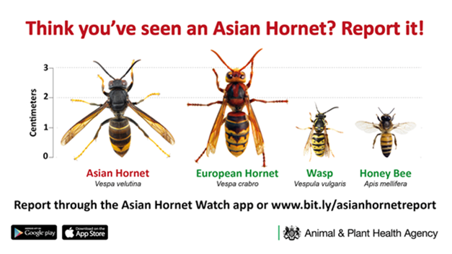
  How to Report Sightings

Slide 21
  Current state of Action in the UK
  Still a DEFRA Led Eradication Policy
  Education - ID and Reporting (BBKA & Action Teams)
  Response to Reports – Credibility Triage NNSS CEH
  Activation of NBU Track & Trace Regional Inspectors
  Nest Removal and Testing for Source and Spread

Slide 22

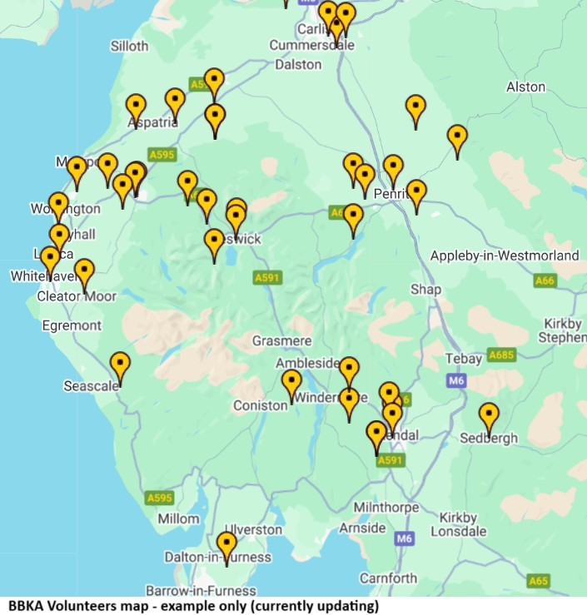
Help by Volunteering
  Monitor and / or Verifier
  Public Awareness / Education
  Cumbria Asian Hornet Team
  Supporting Roles (Admin)

Slide 23
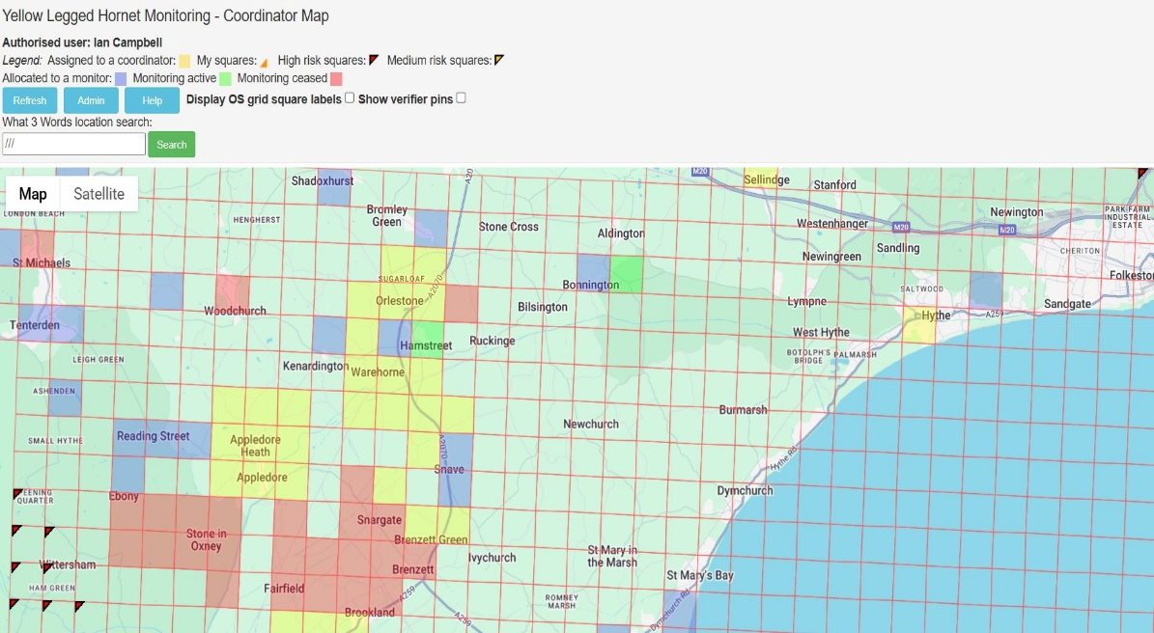
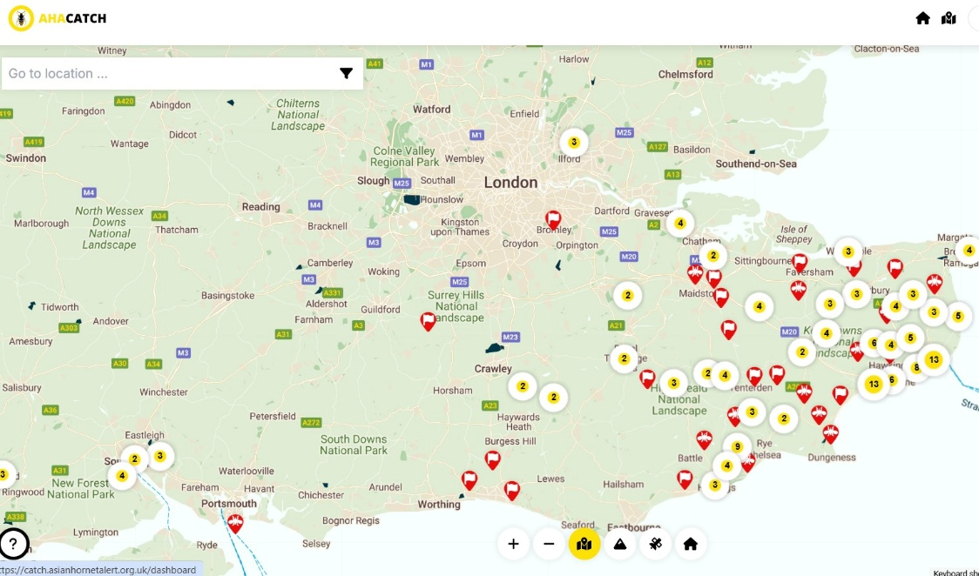
  BBKA Tools and Volunteers
  Volunteers No Longer restricted to BBKA
BBKA’s er2 Monitoring System AHA Catch System of Monitoring

Slide 24
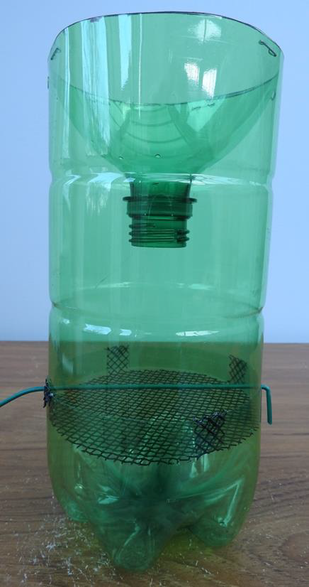
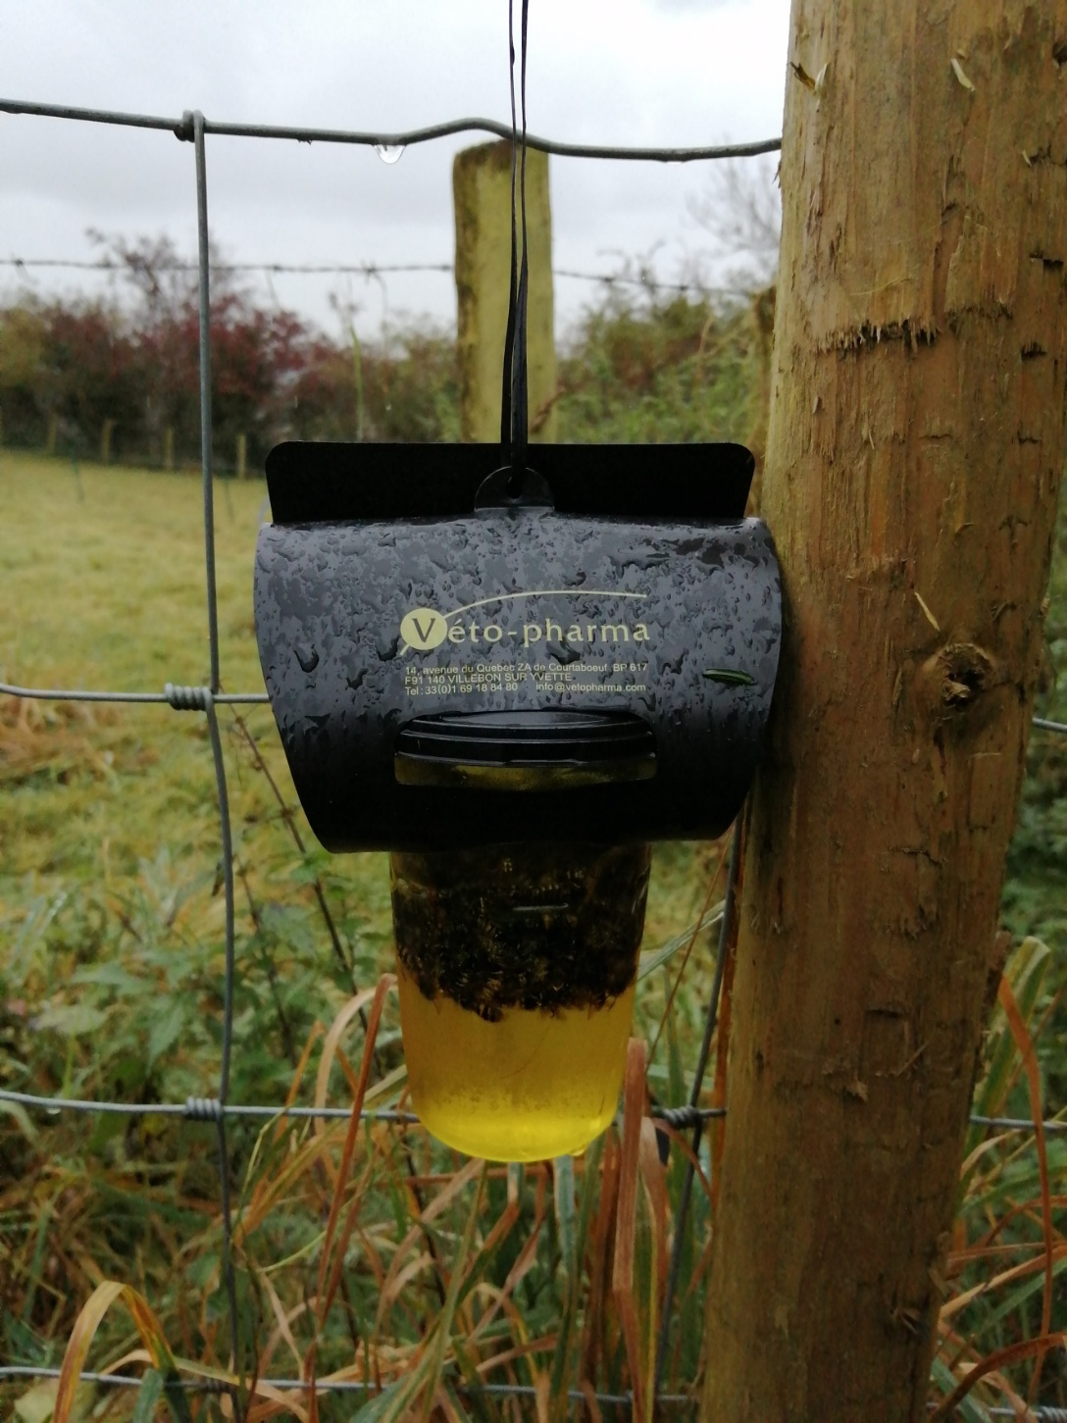
Spring Trapping of Queens
Notes:
Left – BeeBase home made non-killing trap. Purchased trap on right but beneficial insects drown, this is hugely damaging. The black ‘roof’ prevents hornets seeing the bright sky above the entrance holes and impedes the ability to escape.

Slide 25
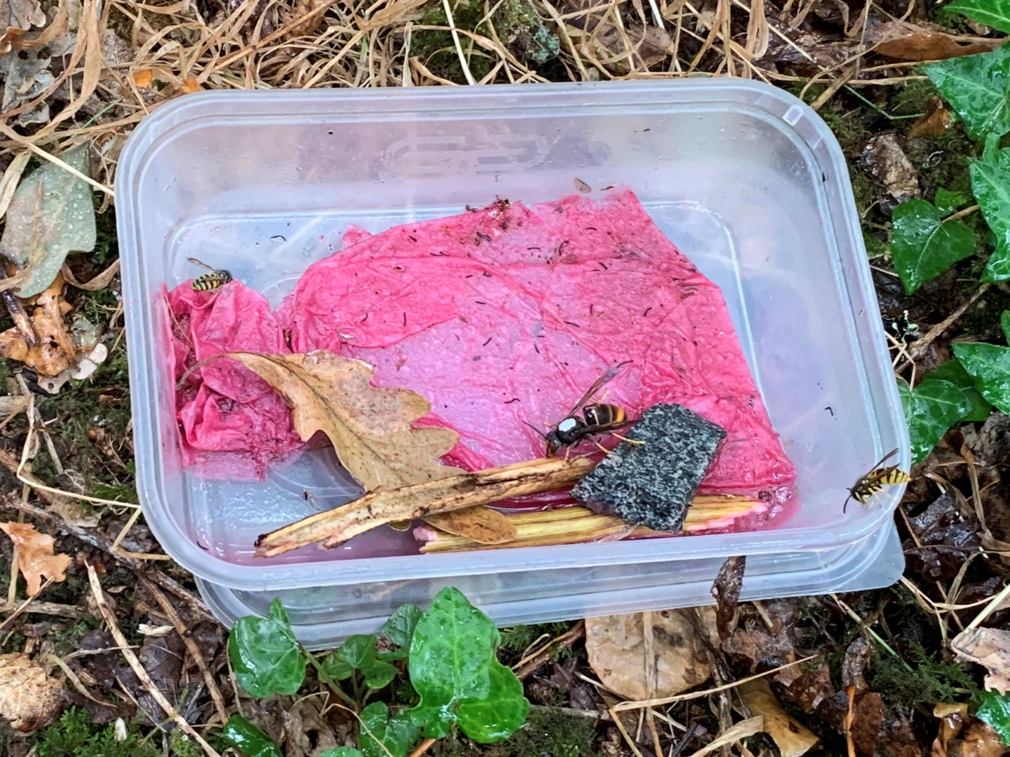
Notes:
An open bait trap for tracking and tracing NB it is still illegal to cage (to mark a hornet) and then release it because it is illegal to release an invasive species

Slide 26
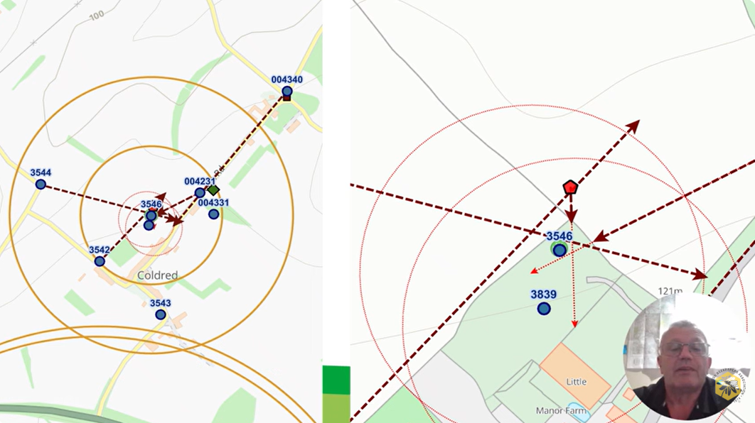

Slide 27
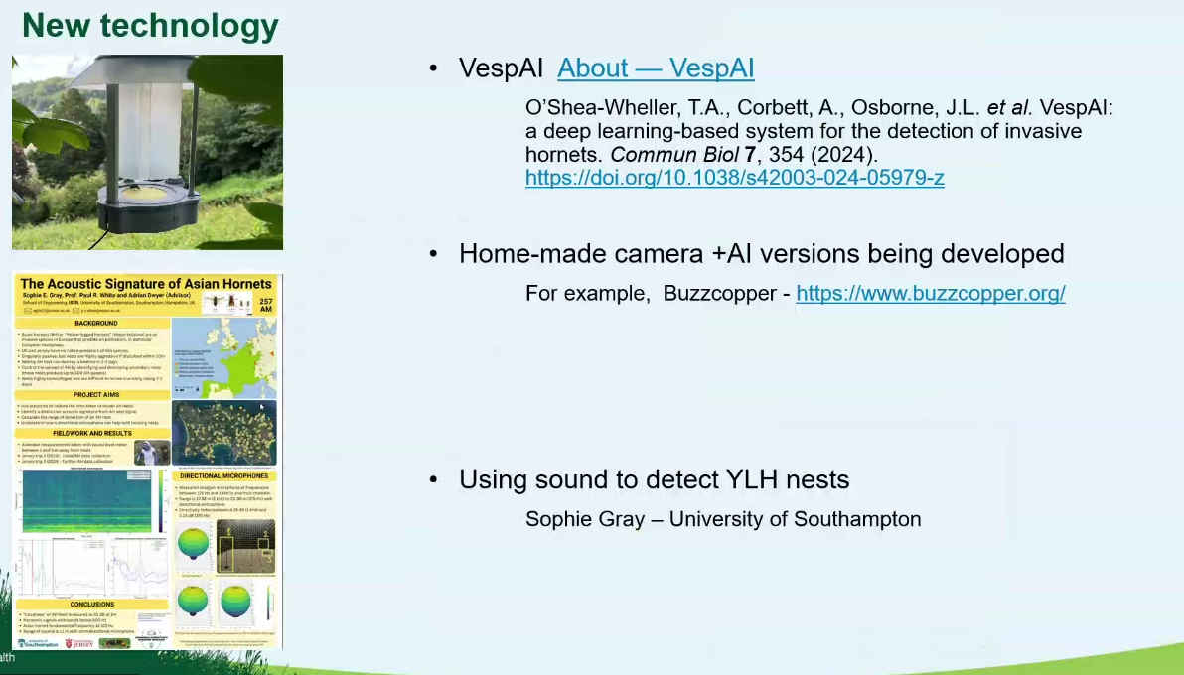

Slide 28
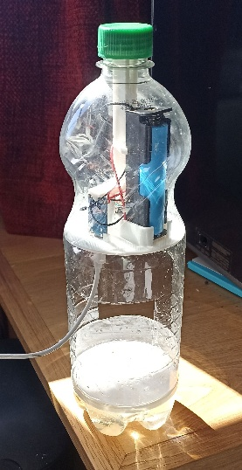
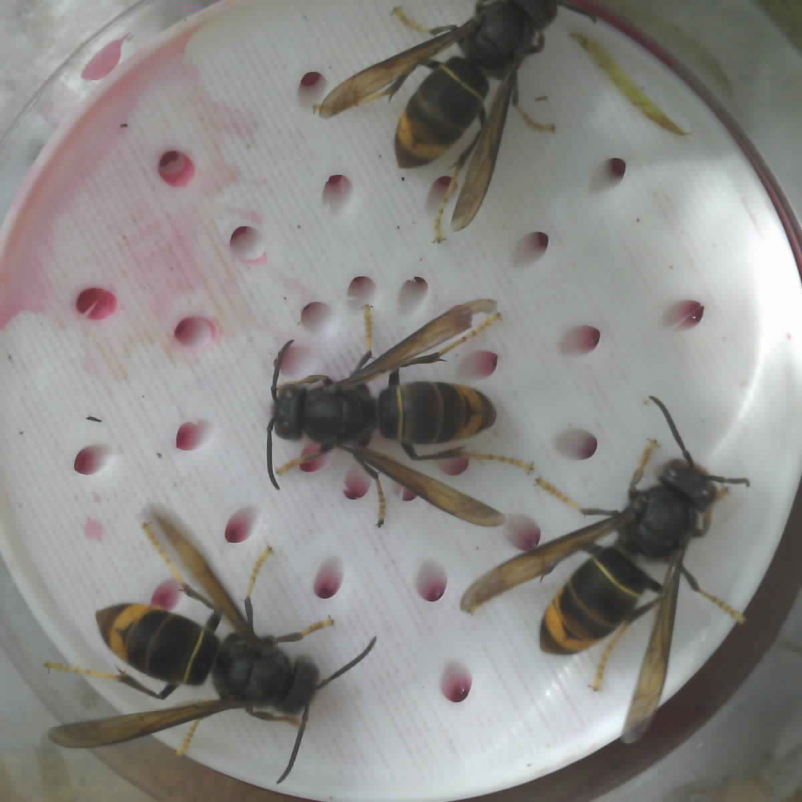
Buzzcopper
Jonathan Semple
New version of AI monitoring
Relatively cheap
Highly reliable
(tested in France)

Slide 29
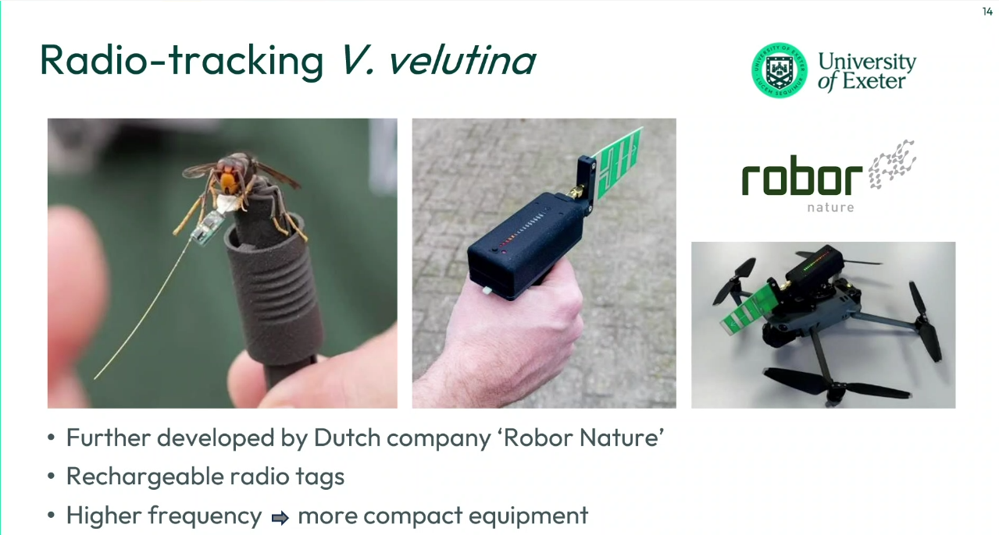

Slide 30


DEFRA – APHA - NBU
New Announcements
No further Spring Trapping
No statement in respect of reduction of DNA testing (FERA)
Committed to Eradication
Notes:
Left – BeeBase home made non-killing trap. Purchased trap on right but beneficial insects drown, this is hugely damaging. The black ‘roof’ prevents hornets seeing the bright sky above the entrance holes and impedes the ability to escape.

Slide 31
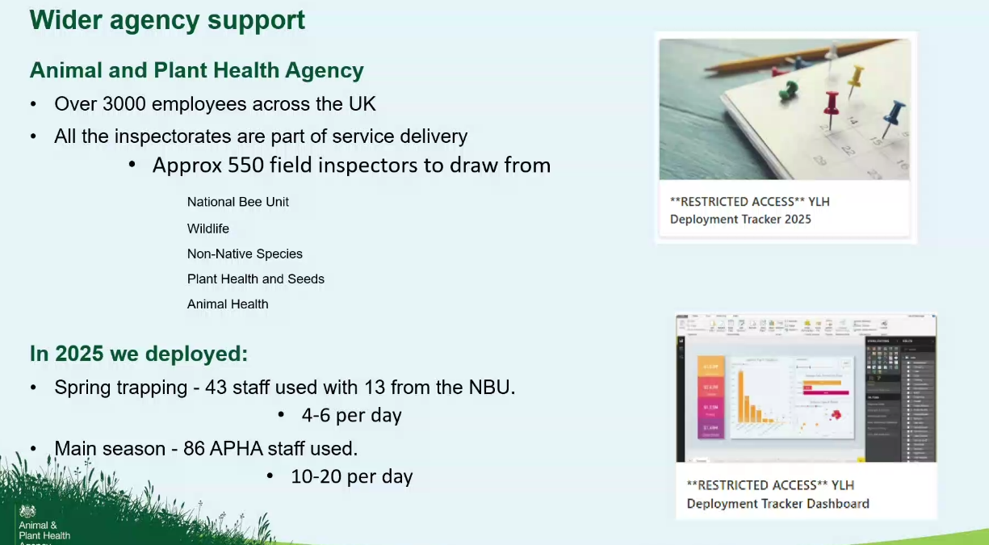

Slide 32



The Future Plans
CIC - Community Interest Company
CIO - Charitable Incorporated Organisation
Notes:
Left – BeeBase home made non-killing trap. Purchased trap on right but beneficial insects drown, this is hugely damaging. The black ‘roof’ prevents hornets seeing the bright sky above the entrance holes and impedes the ability to escape.

Slide 33
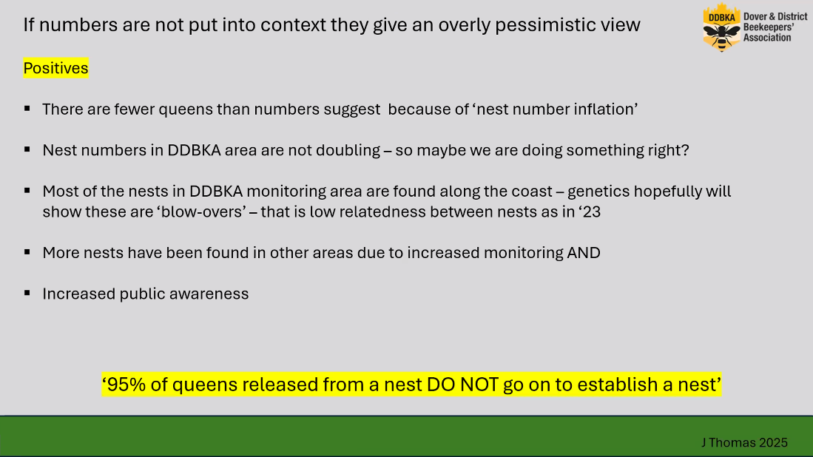

Slide 34
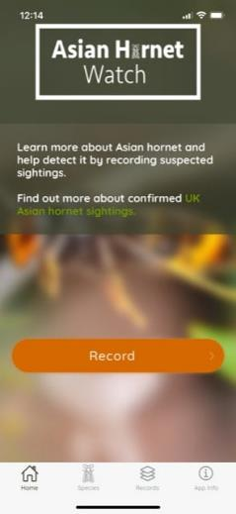



  We Can Contain This!
  But Not Alone – Public Power !
The best way to report sightings is via:
The Asian Hornet Watch app
Alternatively, please email:
alertnonnative@ceh.ac.uk

Slide 35

Credits to:
Dr Pete Kennedy, University of Exeter
Chris Issaac, Jersey
Nigel Semmence, Animal and Plant Health Agency, UK
John Kelly – National Biodiversity Data Centre, Ireland
BBKA AHT
Lucie Chaumeton, YLAH Coordinator for North London Beekeepers
Diane Drinkwater, BBKA Trustee & Chair
Michelle Elliott, Asian Hornet Alert
Jackie Thomas, YLAH Coordinator for Dover & District BKA

Slide 36
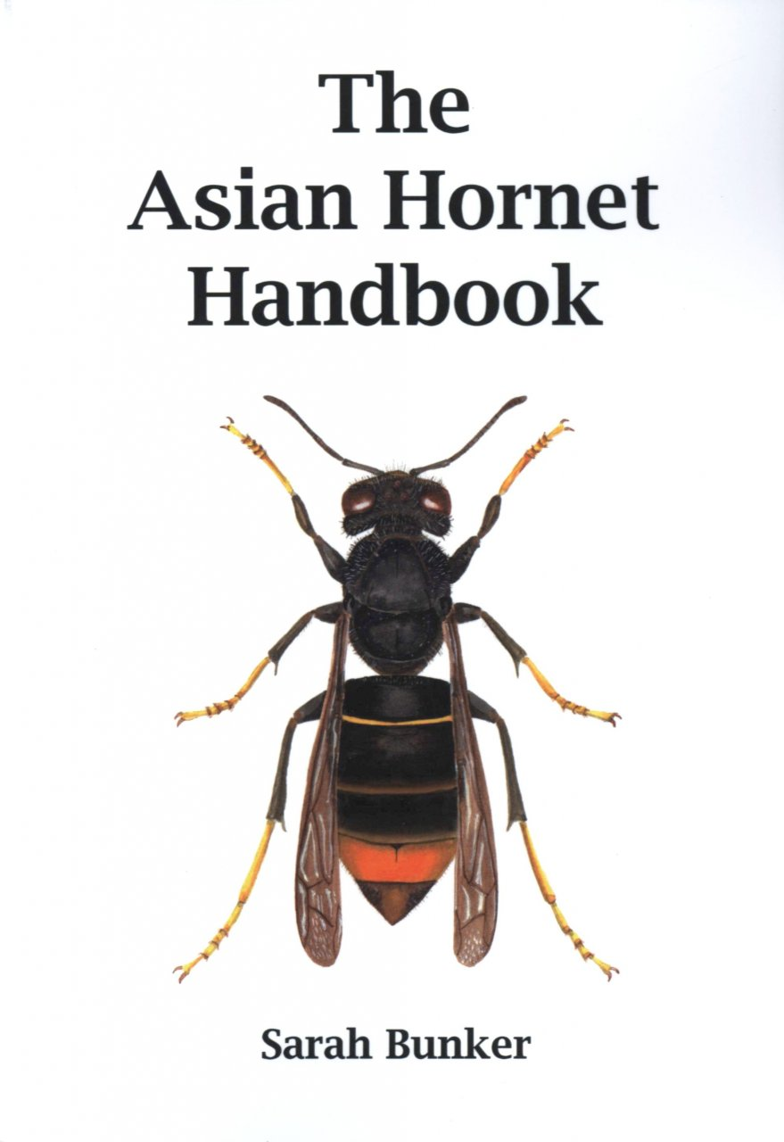
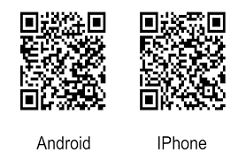
Literature & references :
BBKA –
https://www.bbka.org.uk/Listing/Category/asian-hornet-vespa-velutina
Acknowledgement to Andrew Durham
NBU –
https://www.nationalbeeunit.com/diseases-and-pests/asian-hornet/
Acknowledgement to Julia Hoggard
NNSS –
https://www.nonnativespecies.org/non-native-species/species-alerts/#Species_53
K&SWBKA – https://www.kendalbeekeepers.com/asian-hornet
AH Watch App –
Notes:
This is the book to buy and read to gain an understanding

Slide 37
Thank You
Any Questions ?
One-stop latest and full information with links for the public and beekeepers:
www.kendalbeekeepers.com/asian-hornet

