Slide 1


The Yellow-Legged
Asian Hornet

Slide 2

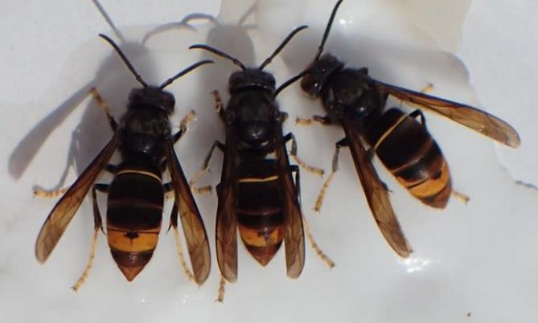
The Yellow-legged Asian Hornet is a non-native invasive species that preys on a wide range of pollinators including honey bees.
Image: Bob Hogge

Slide 3

  Native to Asia
  First seen in France in 2004 – thought to have arrived in a container of pottery from China
  Now present across most of Europe
  UK is facing an increasing threat from this invasive species
  Preys on a wide range of insects including honey bees

Slide 4
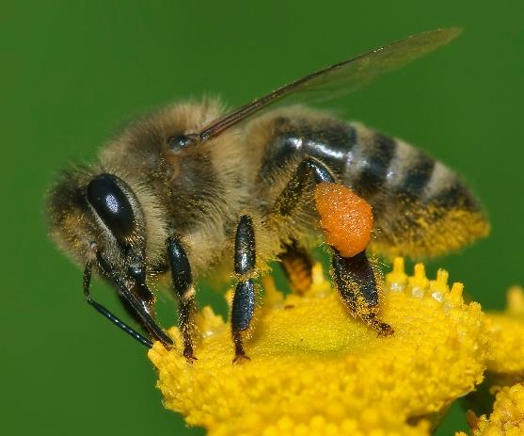
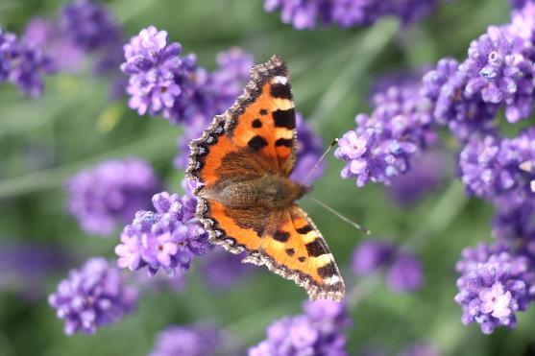
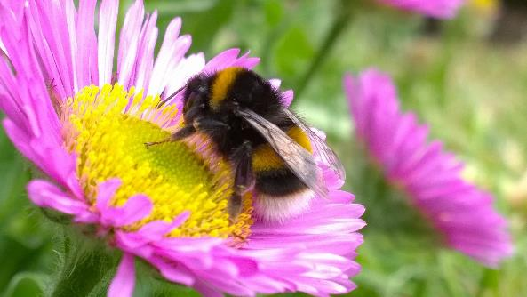
  One nest, of Yellow-legged Asian hornets, can eat 100,000 pollinators in one year
This Photo by Unknown Author is licensed under CC BY-SA

Slide 5

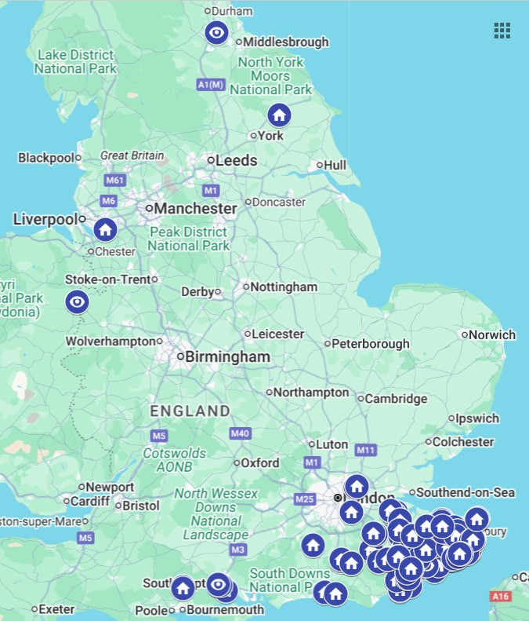
Recent Sightings
As of 4th September 2025, 384 credible Yellow-legged Asian Hornet sightings have been reported in the UK and 96 nests have been found.

Slide 6
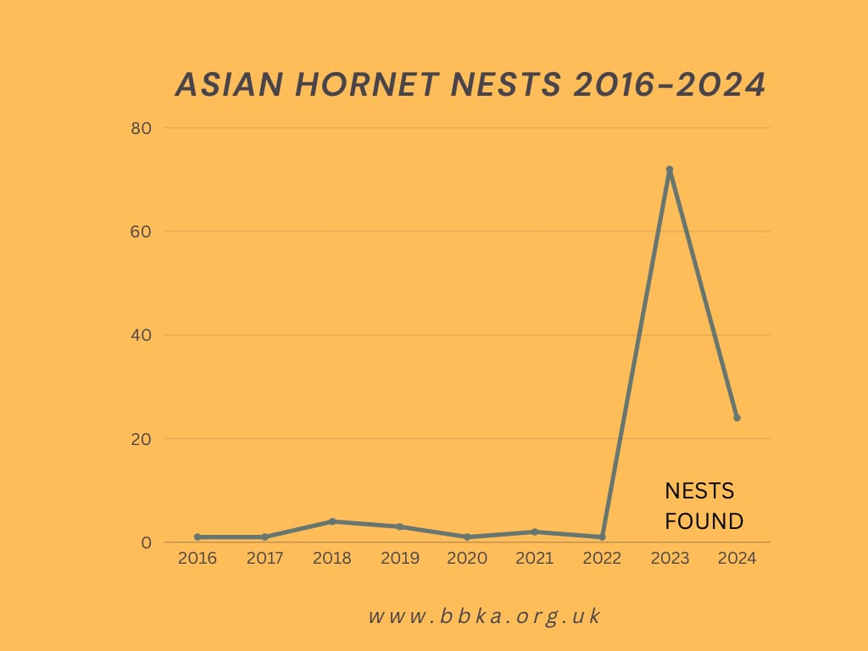
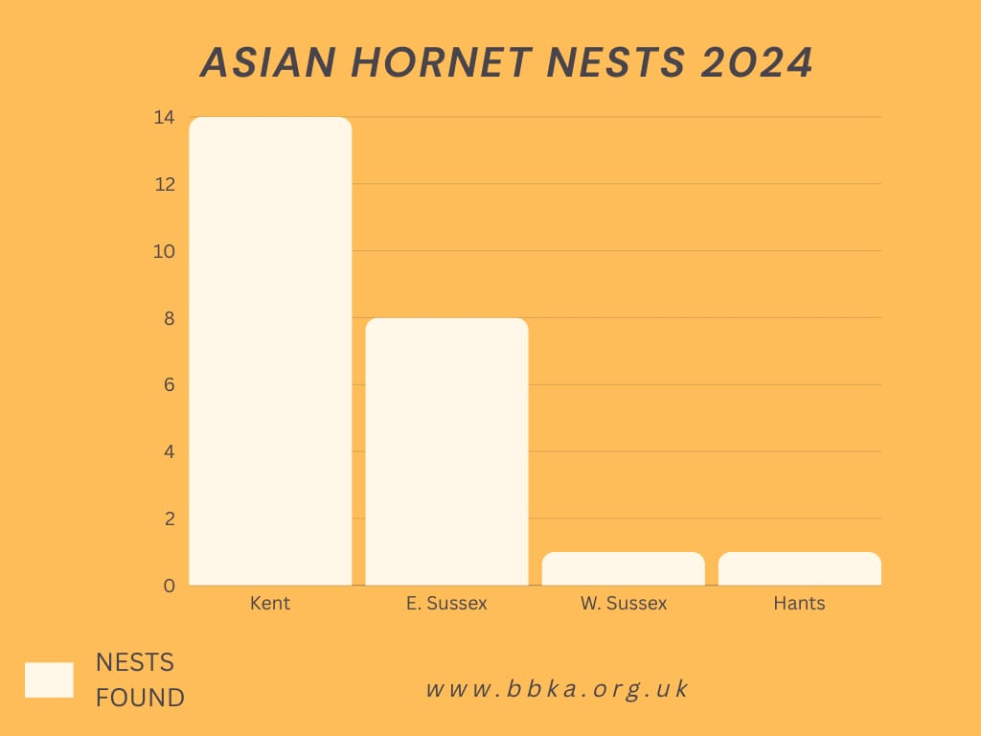
The first Yellow-legged Asian hornet was discovered in the UK in 2016.
More nests were discovered in the UK in 2023 than in the previous six years combined!

Slide 7
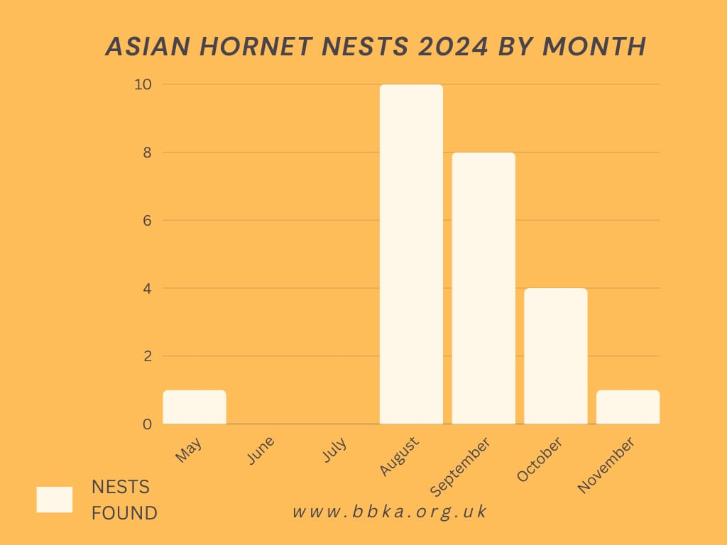
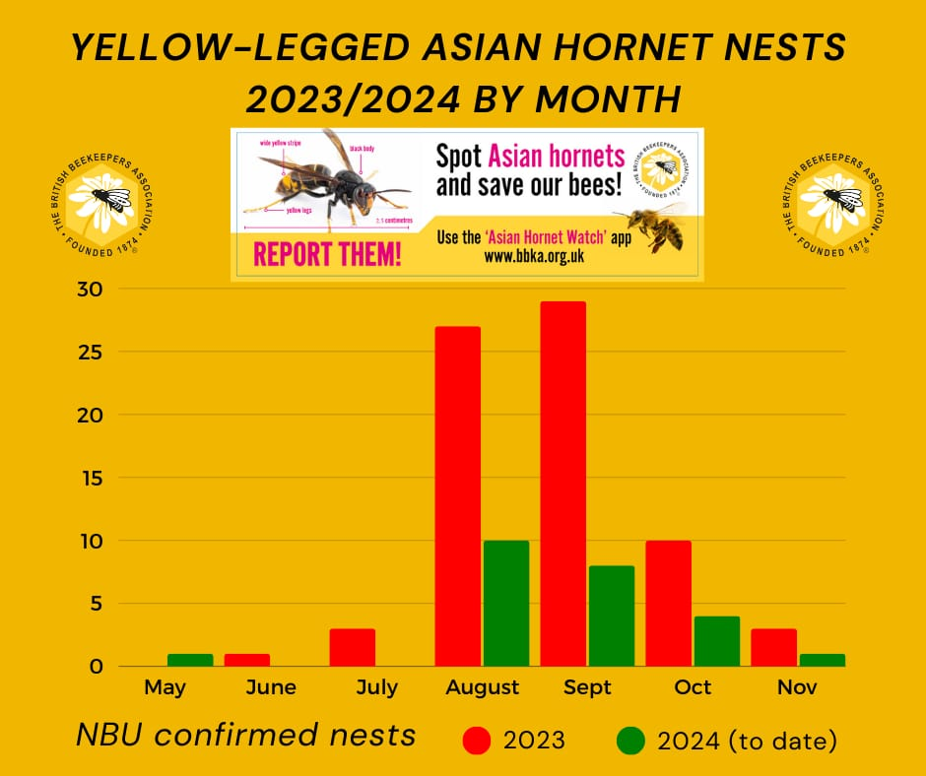

Slide 8
We need your help!
  Learn how to identify Yellow-legged Asian Hornets
  Know how to report any sightings
  Be vigilant
  Spread the word

Slide 9
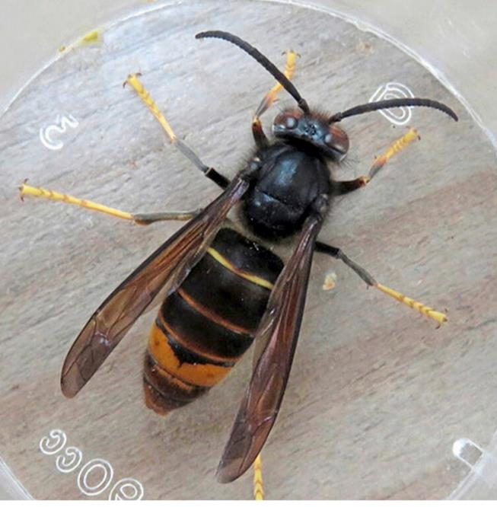
Identification
  Dark abdomen with wide orange stripe on 4th segment
  Yellow tips to legs
  Head black with orange face
  Thorax black & velvety
Image: David Walker

Slide 10

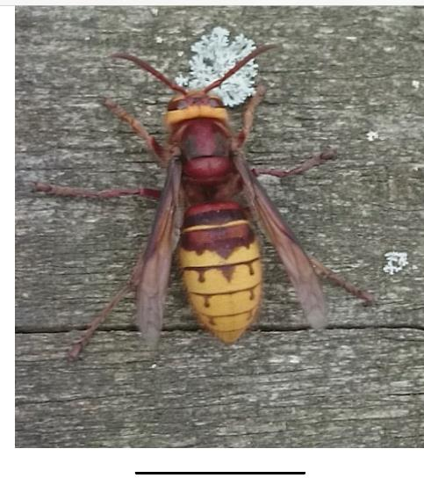
Similar Insects
  Native European Hornet
  Larger in size
  Yellow & brown
  Brown legs
  Yellow headband

Slide 11
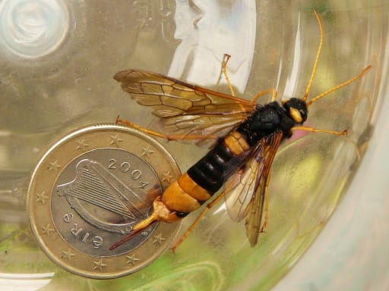
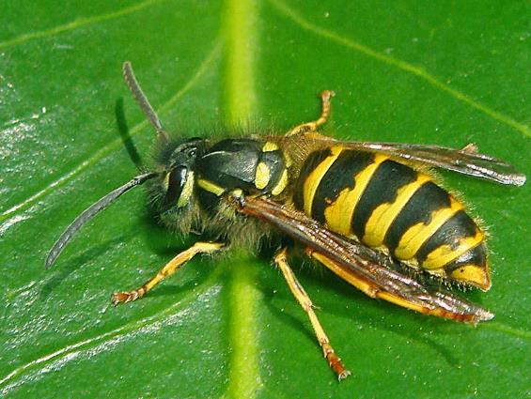
Similar Insects
  Giant Wood Wasp
  Wasp

Slide 12
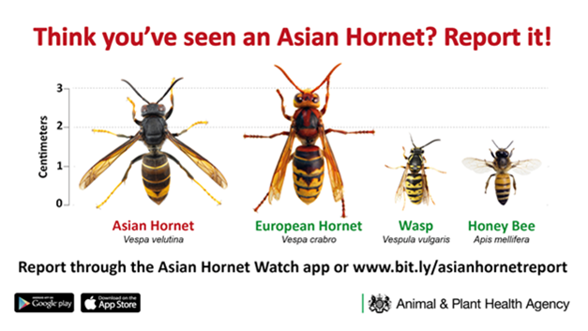

Slide 13

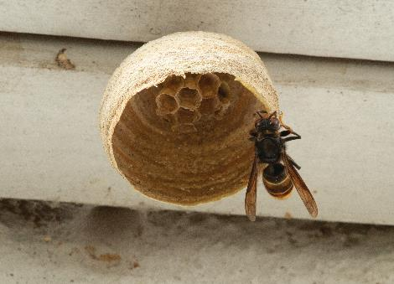
  Spring
  Over-wintered queens become active and start foraging
  Build a primary nest typically in a lowdown sheltered spot and begin the production of a new colony
  Nest is brown in colour, similar to a wasp nest
  Only fly during the day
Image: John De Carteret

Slide 14
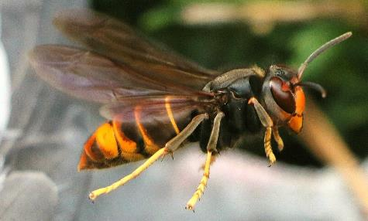
  Summer
Image: Pixabay
  The queens build a larger secondary nest which is typically in an elevated position
  A single colony can produce up to 6000 individuals in one season.
  Can be spotted ‘hawking’ honey bees outside their hive

Slide 15
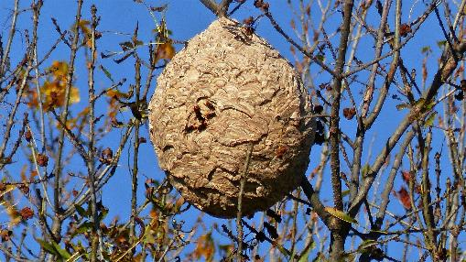
  Autumn
Image: Claude Alleva on Pixabay
  Nests high up in trees more likely to be seen when the leaves start to fall
  Can be seen foraging on flowering ivy and fallen fruit
  Mated queens leave the nest to find a suitable place to over-winter and leave the workers and males to die

Slide 16
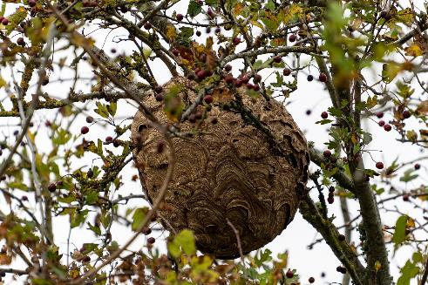
Image: Didier Aires on Pixabay
  Yellow-legged Asian hornets can be extremely aggressive if they feel they are being threatened. Stings are painful and can cause an allergic reaction in some people.
  Do not approach or disturb a nest.

Slide 17
  How to Report Sightings
  If you think you have seen a Yellow-legged Asian hornet or a nest please report it immediately:
  Take a photo if it is safe to do so
  Report via the Asian Hornet Watch app or email
See it! Snap it! Send it!

Slide 18

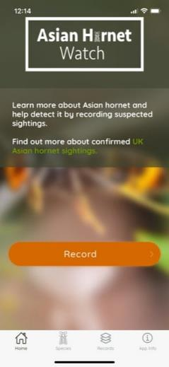



The best way to report sightings is via:
The Asian Hornet Watch app
Alternatively please email:
alertnonnative@ceh.ac.uk

Slide 19

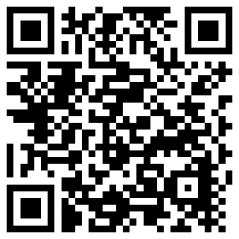
Help to spread the word!
  Tell your family, friends & work colleagues
  Further information and resources available on the BBKA website.

Slide 20
Thank You
Any Questions ?

